Slide 1

Senate Plenary
December, 10th 2024

Slide 2
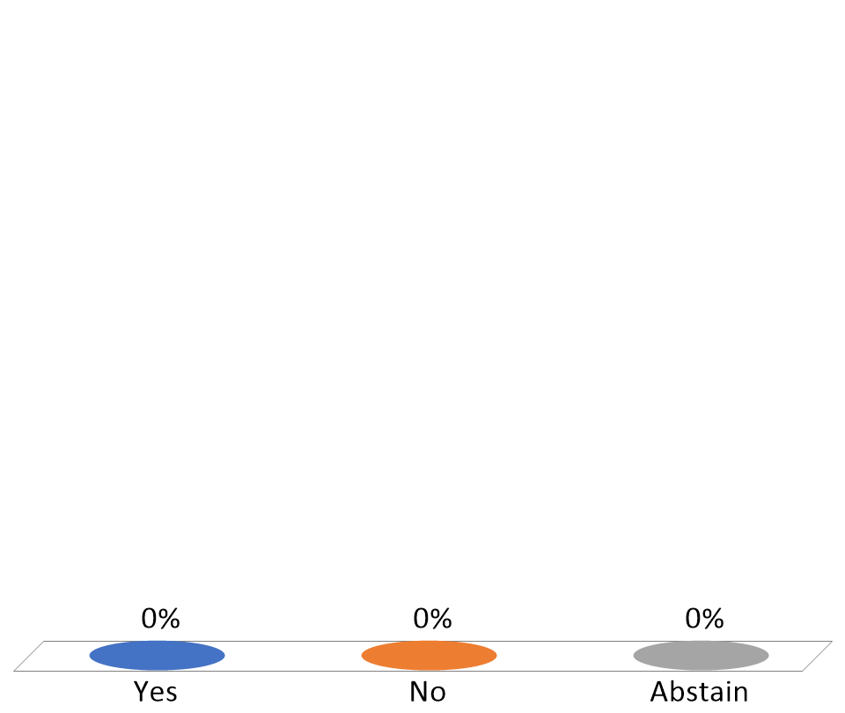
Vote in favor of Minutes for December 10, 2024
Yes
No
Abstain

Slide 3
Vote in favor of Curriculum Item: Course Changes
Yes
No
Abstain

Slide 4
Vote in favor of Curriculum Item: Pathways
Yes
No
Abstain

Slide 5
Vote in favor of Curriculum Item: Revised Major Design
Yes
No
Abstain

Slide 6
Vote in favor of Curriculum Item: Program Closure
Yes
No
Abstain

