Slide 1
Office of Facilities Planning & Operations
Recycling at York College
Local Law No. 50 or 2007 allows non-profit institutions (YC) to have its debris collected
and removal source-separated recyclables by a licensed private vendors with following
proviso:
The filing of a notarized written agreement with the Department of Sanitation (DSNY) with the names and titles of the building/development ownership and the private vendor, the taxpayers identification numbers of all parties, the agreed upon price term, the days of service, and the duration of said agreement.
The weight of recyclables collected from your premises as reported back to you by the private vendor.

Slide 2
Office of Facilities Planning & Operations
Recycling at York College
Supply all recycling receptacles including recycling box and Slim Jims at no charge
Supply 96 gallon toters and 2 yard roll off at no charge
Cardboard, paper and beverage bottles one pick up per week at no cost
Implement a recycling programs at no charge
Rebate based on quality and volume and market conditions
If either party terminates contract supplied equipment will be returned to royal

Slide 3
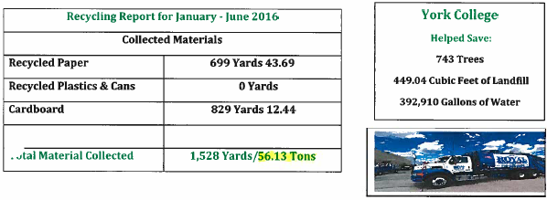
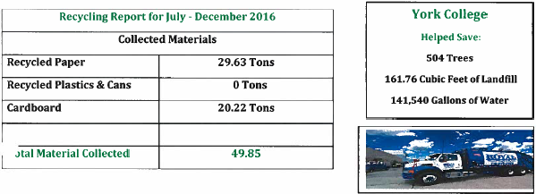
Office of Facilities Planning & Operations
Recycling at York College

Slide 4
Office of Facilities Planning & Operations
Recycling at York College

Slide 5
Office of Facilities Planning & Operations
Recycling at York College

Slide 6
Office of Facilities Planning & Operations
Recycling at York College
Modification to the York College Recycling Program.
Modifications:
Reduce the variety of containers to separate recycled materials
Update recycling procedures
NYC Sanitation vs. Royal Waste Carting (who takes what?)
Specify the day of the week when recycling materials will be collected around campus
Retrain custodial and supervisory staff in proper recycling procedures
Publicized recycling campaign
Establish ownership of recycling program among Administrative Superintendents

Slide 7
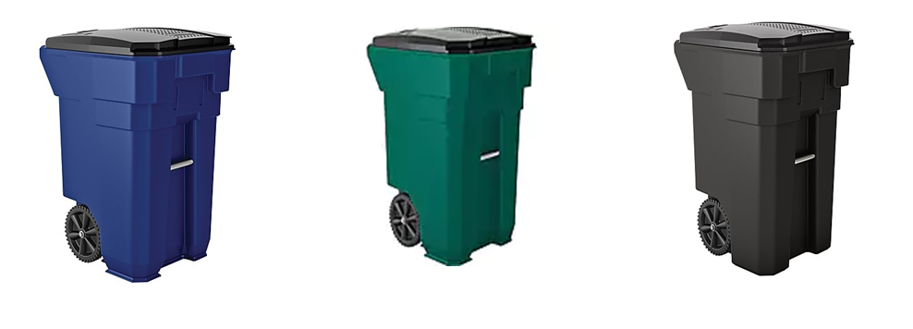
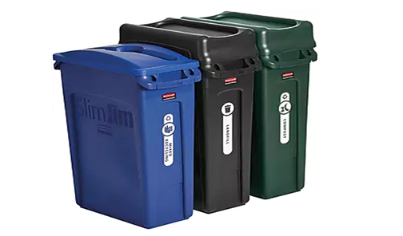
Office of Facilities Planning & Operations
Recycling at York College
Campus Hallways
Suites, Offices & Classrooms

