Slide 1

Laboratory Safety
CUNY
Benjamin Daggett, CHMM
University Environmental Compliance Director
Office of Environmental, Health, Safety and Risk Management

Slide 2
Topics We’ll Cover
Chemical hazard awareness
Control of chemical exposures
Chemical storage/transportation/shipping
Chemical waste management
Emergency response

Slide 3
Gather Information
Sources
  Manufacturer Label
  DOT and NFPA Labels
  SDS
  Reference books - NIOSH http://www.cdc.gov/niosh/npg/default.htm
  Chemical safety database
  CUNY Lab Safety Manual
  BC Chemical Hygiene Plan
  Exposure limits:
  OSHA Regs https://www.osha.gov/dsg/annotated-pels/
  ACGIH TLVs http://www.acgih.org/TLV/

Slide 4
Gather Information
OSHA Lab Standard (29 CFR 1910.1450)
  https://www.osha.gov/pls/oshaweb/owadisp.show_document?p_table=STANDARDS&p_id=10106
NYS Right to Know/OSHA HazCom
(29 CFR 1910.1200) https://www.osha.gov/dsg/hazcom/standards.html
CUNY Lab Safety Manual
  http://www2.cuny.edu/research/student-resources/laboratory-safety-manual/
Chemical Hygiene Plan
  Each laboratory responsible for developing Lab Safety Plan

Slide 5
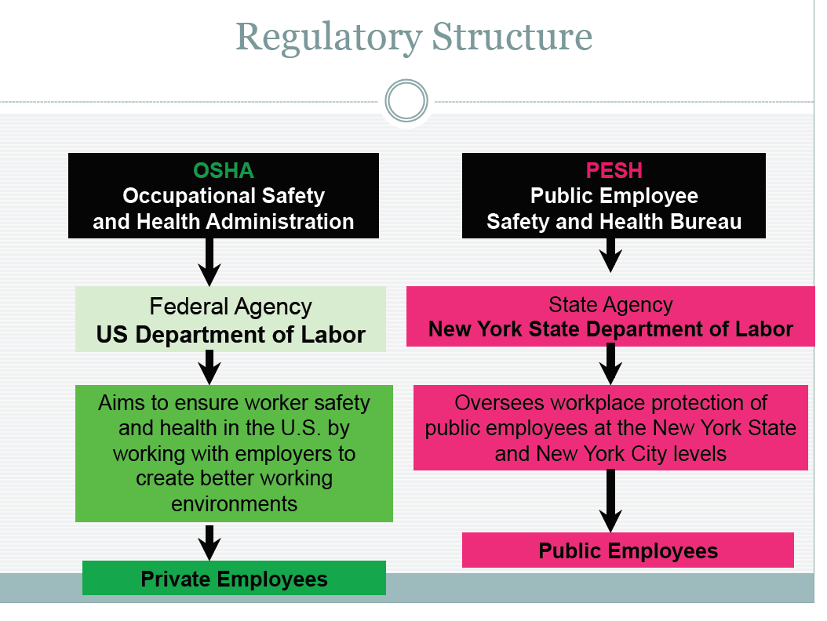

Slide 6
OSHA Lab Safety Standard Requires Employer to inform workers of:
The content of the OSHA Laboratory standard and its appendices
The location and availability of the Chemical Hygiene Plan;
Permissible exposure limits (PELs) for OSHA-regulated substances, or recommended exposure levels for other hazardous chemicals where there is no applicable standard;
Signs and symptoms associated with exposure to hazardous chemicals in the laboratory; and
The location and availability of reference materials on the hazards, safe handling, storage and disposal of hazardous chemicals in the laboratory, including, but not limited to, SDSs.

Slide 7
OSHA Lab Safety Standard Requires Training to Include:
Methods and observations used to detect the presence or release of a hazardous chemical.
These may include employer monitoring, continuous monitoring devices, and familiarity with the appearance and odor of the chemicals;
The physical and health hazards of chemicals in the laboratory work area;
The measures that workers can take to protect themselves from these hazards, including protective equipment, appropriate work practices, and emergency procedures;
Applicable details of the employer’s written Chemical Hygiene Plan;
Retraining, if necessary.

Slide 8
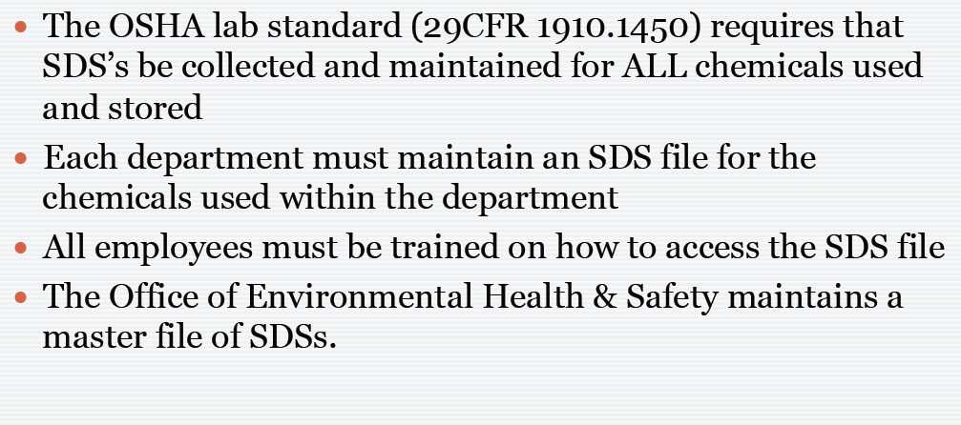
Safety Data Sheets - SDS

Slide 9
Safety Data Sheets - SDS
  new format has improved readability but…
  quality still varies
  presumes industrial use
  helpful info includes:
    physical/chemical properties
    visual appearance or odor
    personal protection
    signs / symptoms of chemical exposure
    permissible exposure limits (if established)

Slide 10
Safety Data Sheets Must Include
Section I – Identification
Section II – Hazard(s) Identification
Section III – Composition/Ingredients
Section IV – First Aid
Section V – Fire-fighting
Section VI – Accidental Release
Section VII – Handling & Storage
Section VIII – Exposure Control/PPE
Section IX – Physical /Chemical Properties
Section X - Stability & Reactivity
Section XI – Toxicology Information
Section XII- Ecological Information
Section XIII-Disposal Consideration
Section XIV- Transportation
Section XV – Regulatory Information

Slide 11
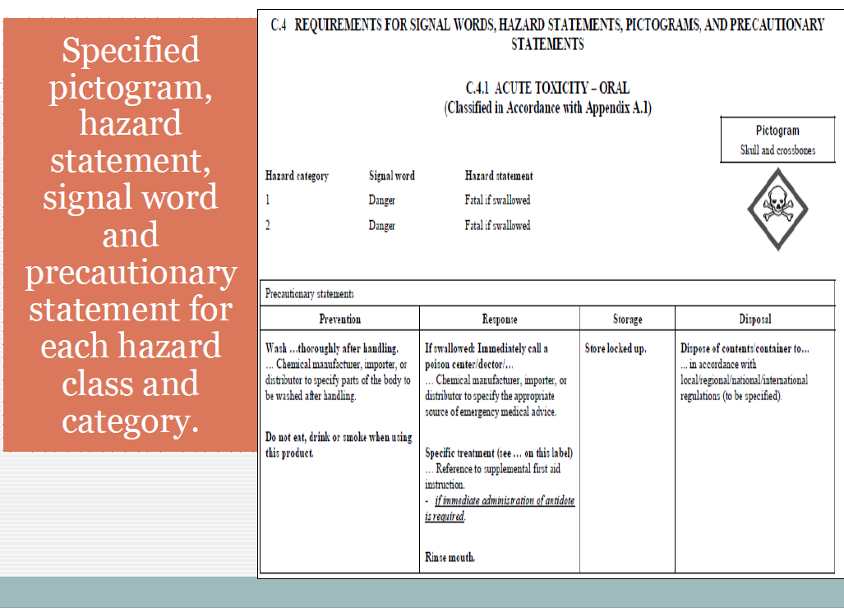
All Bottles Must Be Labeled

Slide 12
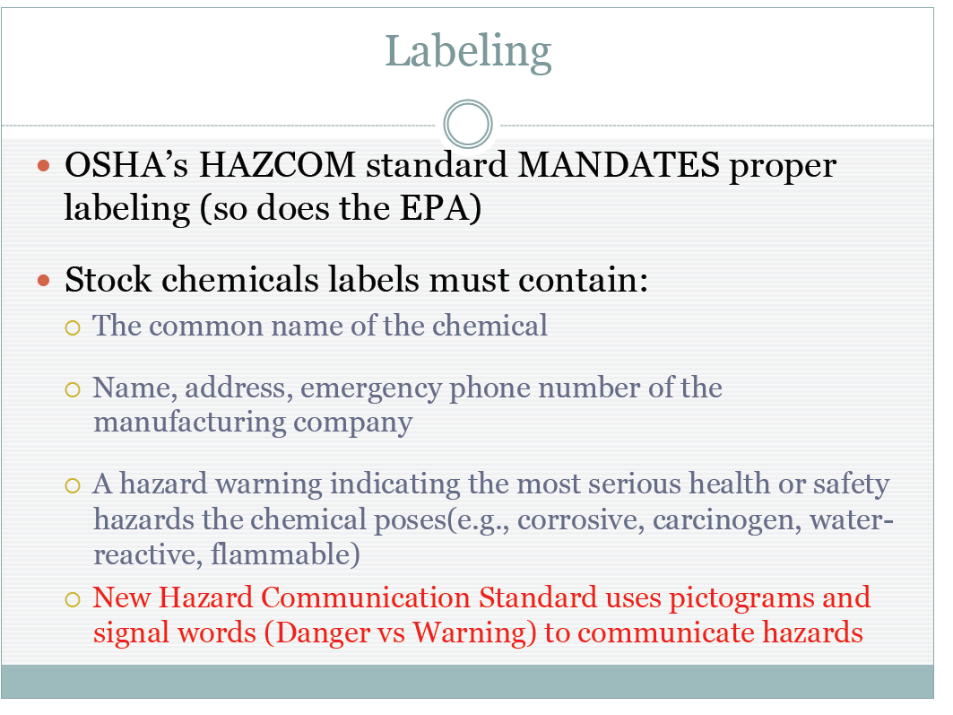

Slide 13

PLAN: Gather Information [GHS Video]
Notes:
Reactive (explosive) –can instantly ignite or produce poisonous vapors when exposed to heat air water or shock e.g. explosive oxidizers, peroxides
Toxic – poisonous or long-term illness, harmful or fatal if swallowed, requires ventilation e.g. carcinogen, sensitier, irritant
Corrosive – can eat through material or living tissue. Burns upon contact eyes, skin, throat e.g. ammonium hypoxide HCl, sodium hypochlorite
Flammable – can catch fire easily , may be combustible or cause fire through friction, not use near flame or spark e.g.pyphorics, flammable gases, self-heating chemicals

Slide 14

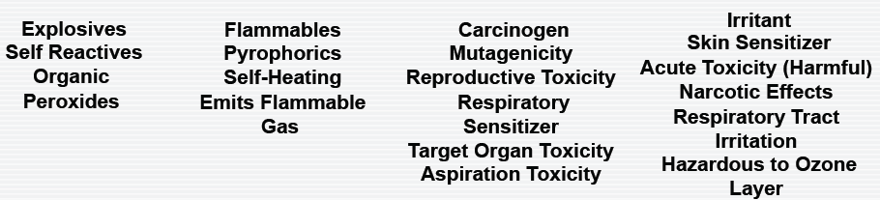
PLAN: Gather Information
Notes:
Reactive (explosive) –can instantly ignite or produce poisonous vapors when exposed to heat air water or shock e.g. explosive oxidizers, peroxides
Toxic – poisonous or long-term illness, harmful or fatal if swallowed, requires ventilation e.g. carcinogen, sensitier, irritant
Corrosive – can eat through material or living tissue. Burns upon contact eyes, skin, throat e.g. ammonium hypoxide HCl, sodium hypochlorite
Flammable – can catch fire easily , may be combustible or cause fire through friction, not use near flame or spark e.g.pyphorics, flammable gases, self-heating chemicals

Slide 15
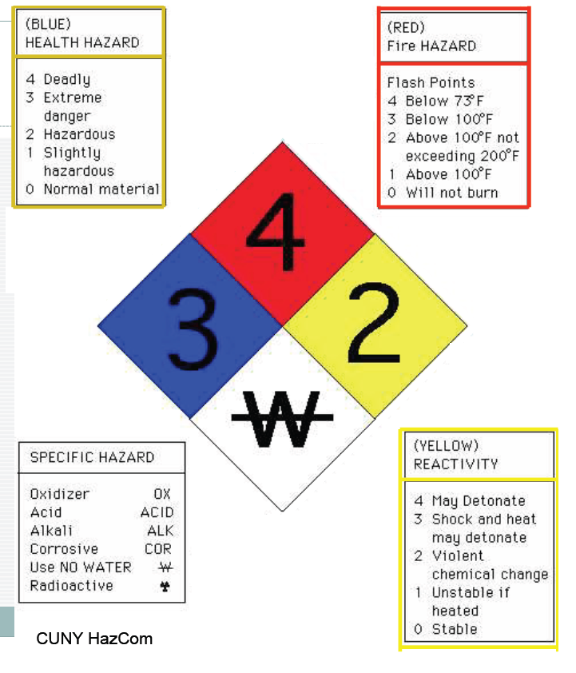

Slide 16
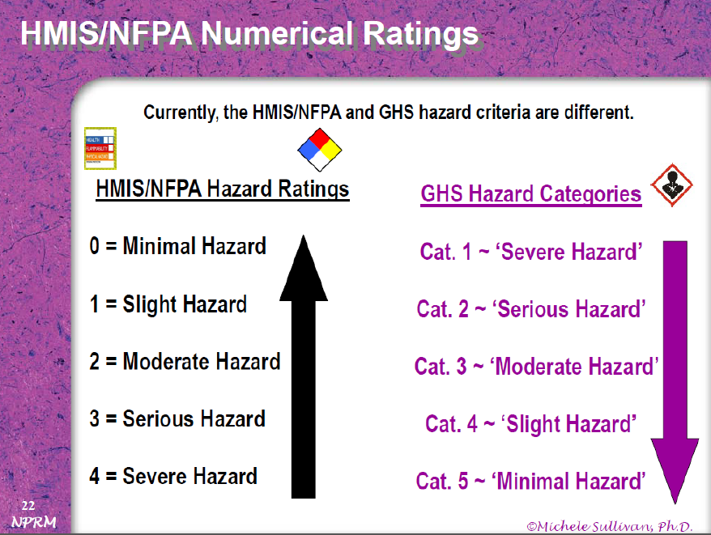

Slide 17
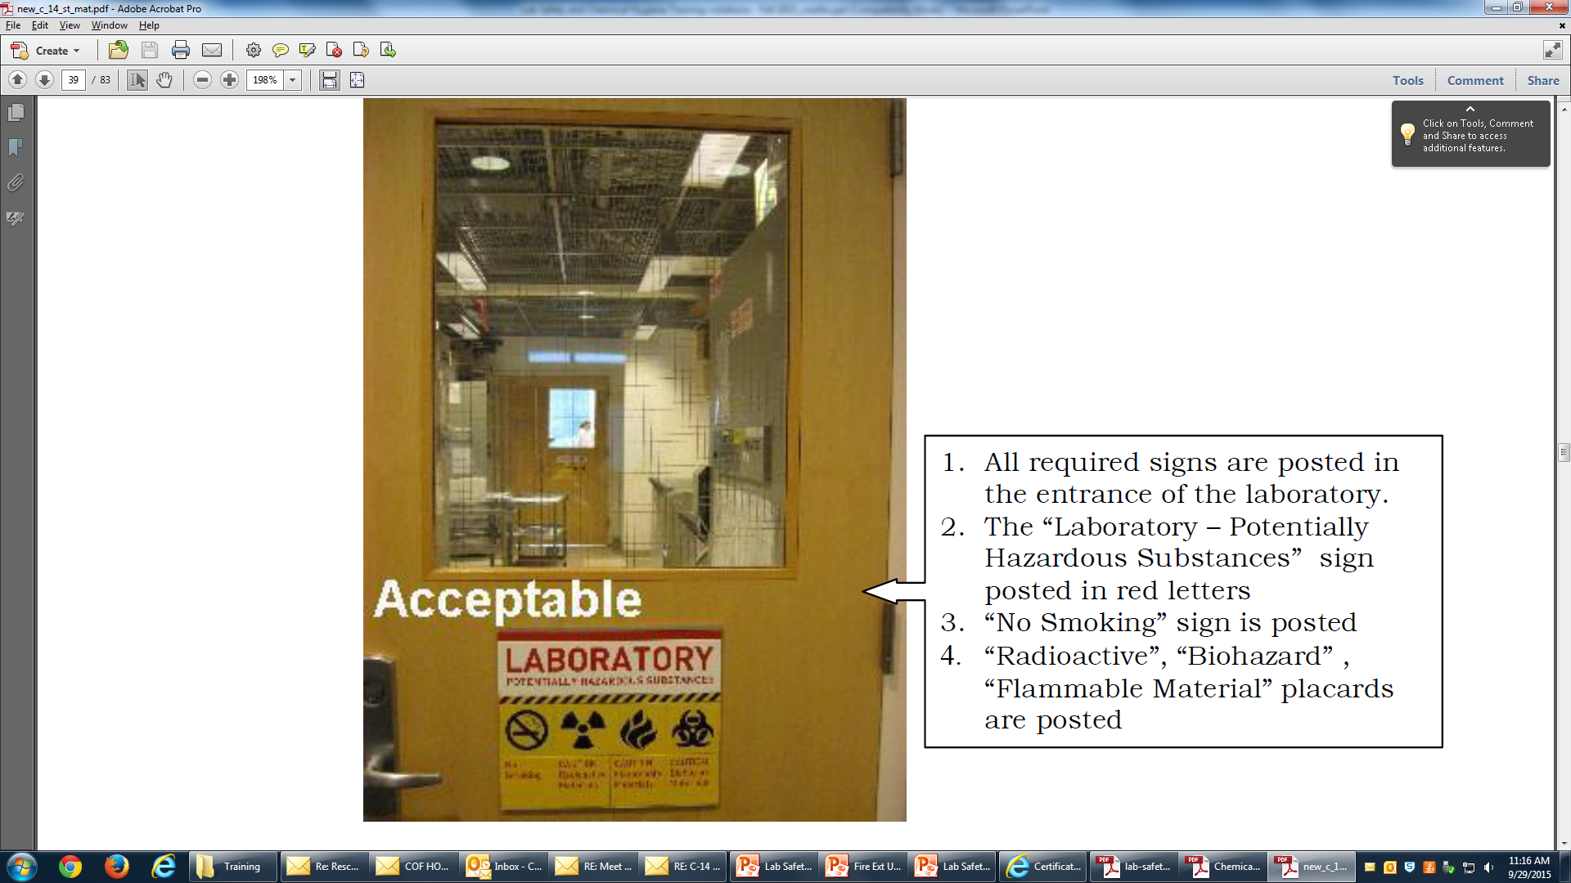
Know Your Lab
REQUIRED SIGNAGE
Laboratory – Potentially Hazardous Substances
No Smoking
Signage for Unique Hazard – radiation, biohazard, flammable material

Slide 18
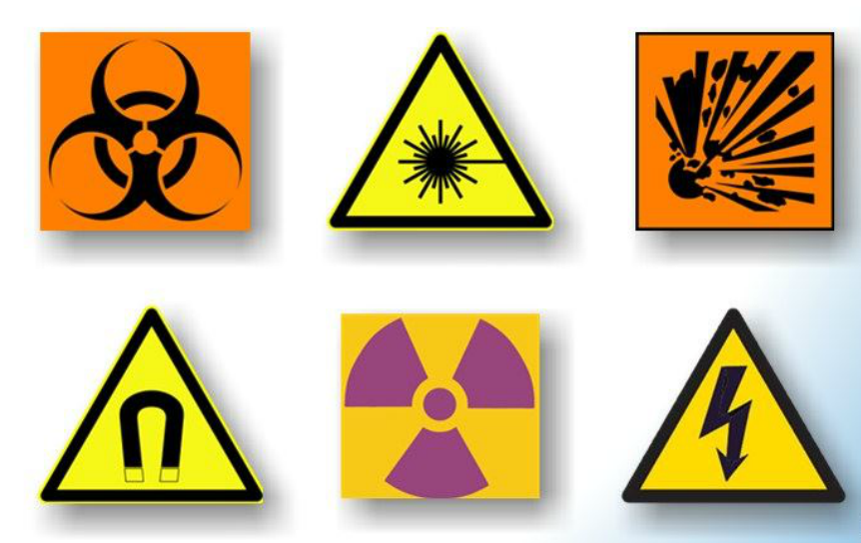
Door Signage

Slide 19
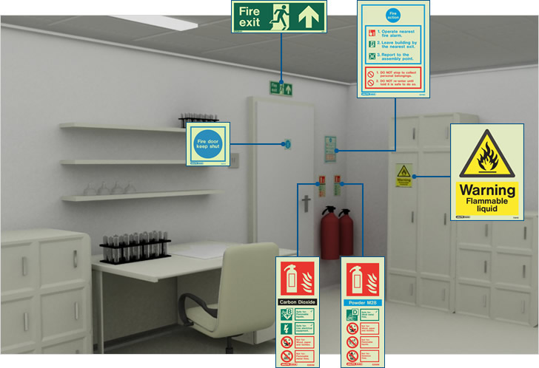
Lab Room Signage
No Eating or Drinking
Emergency #s
xxx-xxxx
xxx-xxxx
xxx-xxxx

Slide 20
Know the Chemical
Physical Hazards:
  Flammability, corrosivity or reactivity
Health Hazards:
  Acute Health Hazards
    High concentration (ceiling limit), short exposure duration
    Damage happens quickly
  Chronic Health Hazards
    Low concentration, long exposure duration
    Long latency (symptoms may appear long after exposure)

Slide 21
Assessing Hazard Level
Depends on:
  Chemical: toxicity, concentration
  Use: duration, frequency, amount
Evaluation may include:
  Baseline survey or audit
  Observation of work practices, personal protective equipment (PPE), engineering controls
  Air monitoring

Slide 22
Detecting Possible Exposure
Sight - Seeing a container spill, liquid pooled on the floor, or fumes or smoke coming from an area are clues that a material has been released and your supervisor (and possibly Campus Security) should be notified.
Smell - Odor is an unreliable, and often dangerous, way to detect a release. If you smell a hazardous material, it has already entered your body. Some chemicals have distinct odors at low levels while others may not. Noticing odors not usually present or that seem stronger than normal should be reported immediately.

Slide 23

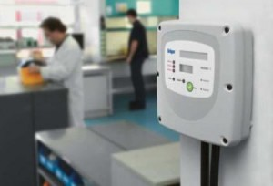
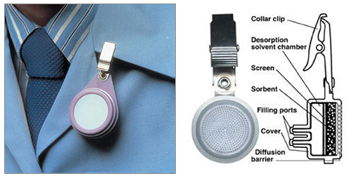
Detecting Possible Exposure
Process Monitoring - Using air monitor equipment is very useful for detecting odorless, invisible material. It’s also useful to quantify exposure potential and compare to health limits.
Real-time Gas Detection
Lab Analysis Required
Fixed Sensor Portable Sensor Personal Exposure
Sampling

Slide 24
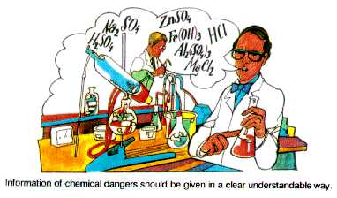
Controlling Hazards
1) Substitute to less toxic material or less
hazardous procedure (microscaling)
2) Use of engineering controls
  Ventilation, isolation
3) Use of administrative controls
  Ensuring safe work practices, rotating staff
4) Use of personal protective equipment
  Gloves, safety glasses/goggles

Slide 25
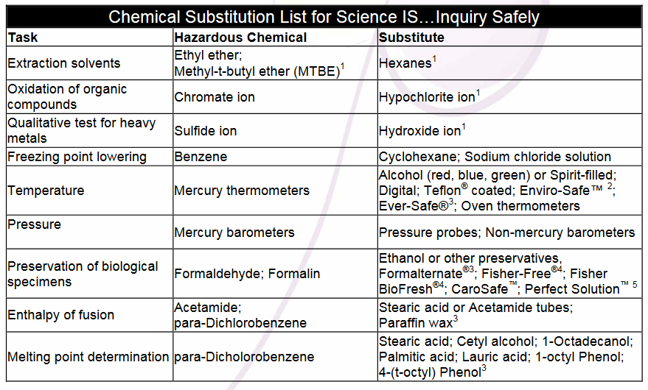
Substitute where possible source: http://www.sciencesafetyconsulting.com/pdf/chemical_substitutions.pdf

Slide 26
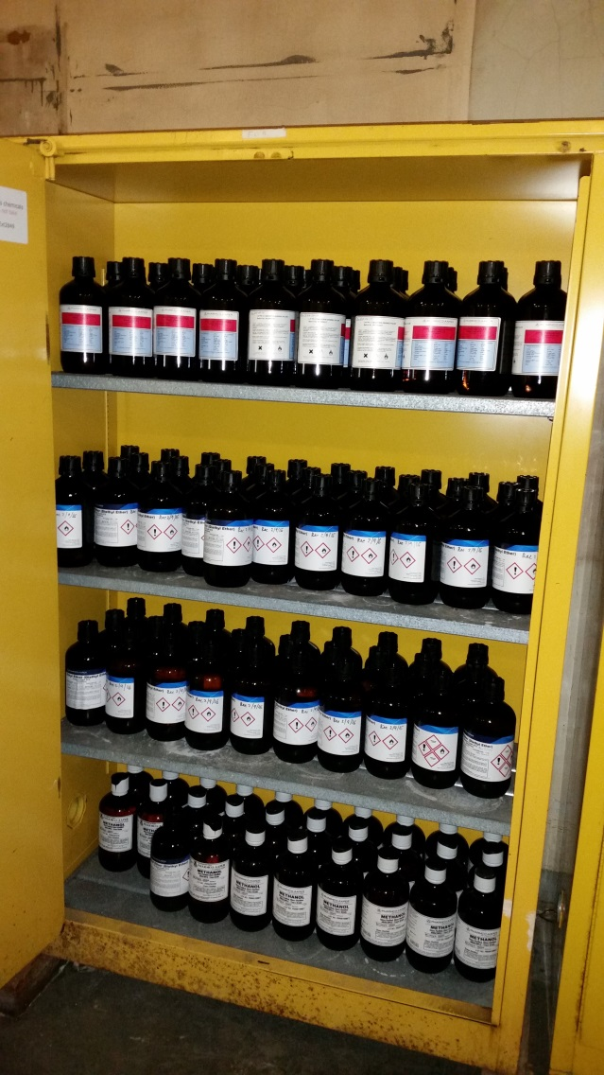
Waste Reduction
Purchase only what you
plan to use
Check inventory prior to
any purchase
Inventories only remain as
accurate as your lab keeps it!

Slide 27

Exposure Control
Inhalation: Lab hoods
Use For All Operations Where Odoriferous, Volatile, Toxic or Harmful Release Possible
Designed to:
(1) Exhaust contaminant away from breathing zone
(2) Provide some splash protection
(3) Will not contain or withstand explosions.
Never put your head inside the hood!
Close chemical containers
Biosafety Cabinet ≠ Fume Hood
Notes:
Chemicals with a National Fire Protection Association (NFPA) Health rating of 3 or 4
Toxic volatile materials (chloroform, formaldehyde)
Flammable chemicals
Carcinogens or particularly hazardous substances
A procedure that may create an aerosol of a toxic substance
Reactive or explosive materials or chemicals that may spatter
Toxic gases (NH3, CO, F2, Cl2, H2S, NO2, etc.)
Odorous materials, both hazardous and non-hazardous

Slide 28
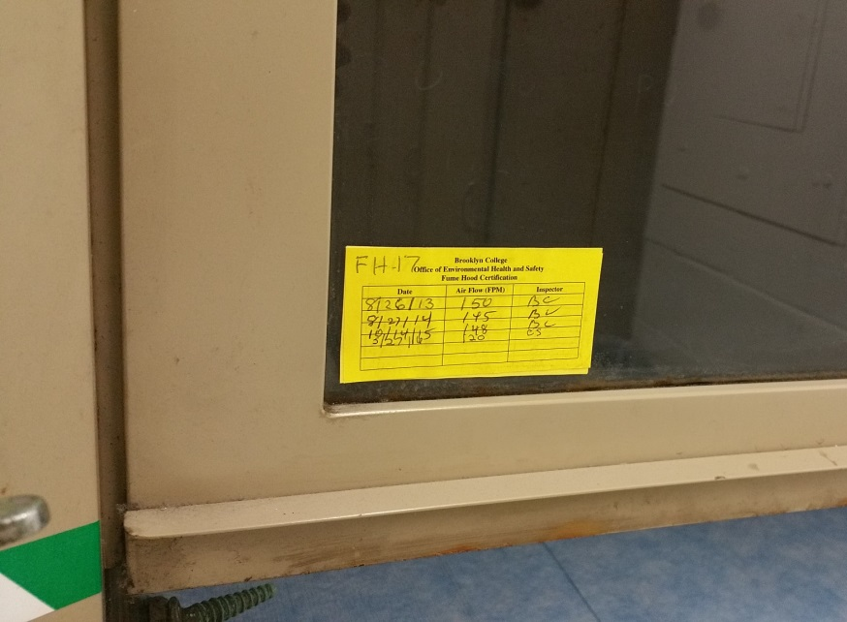
Exposure Control
Inhalation: Lab hoods
To limit turbulence &
maximize performance:
  Current certification
  Sash 12-18”
  Leave 6” at front and back
  Elevate large equipment
  Minimize storage
  Do not block back slot

Slide 29
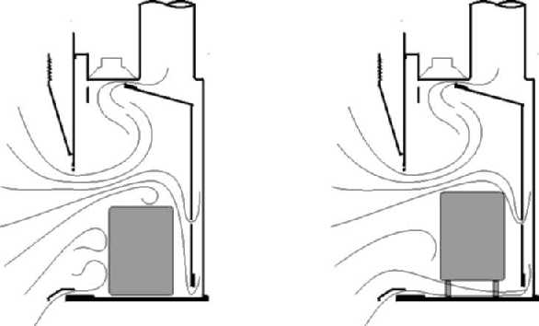
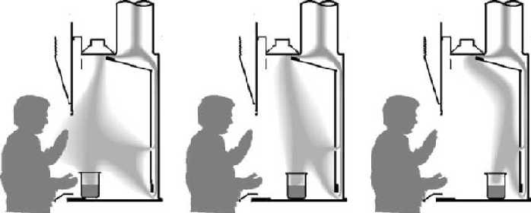
Exposure Control

Slide 30
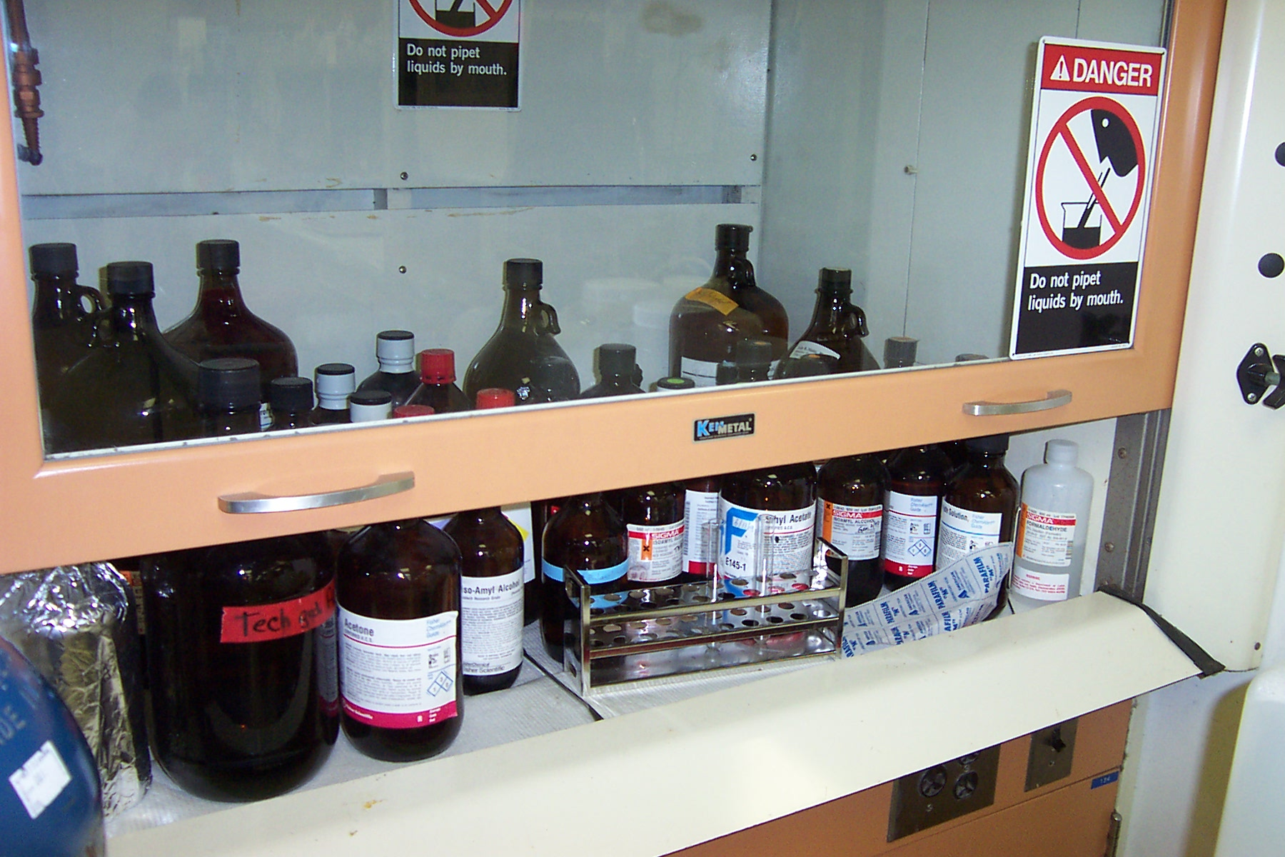

Slide 31
Exposure Control
Personal Protective Equipment [VIDEO]
KNOW what your lab requires
Based on a hazard assessment
Signs may indicate minimum
requirement
Written procedures should specify additional protection needed

Slide 32

Exposure Control
    Absorption: Gloves
    Disposable / reusable
      Disposable vs. Reusable
    Glove material choice:
      protection
      side effects (latex allergies?)
      ease of use (durability / tactility / grip)
      cost
    Double gloves may be necessary
    Check CUNY Lab Safety Manual for glove selection: http://www2.cuny.edu/research/student-resources/laboratory-safety-manual/

Slide 33

Exposure Control
Absorption: Eye/ Face Protection
Labs are eye hazardous areas
Safety glasses, goggles
Face shields
Consider
  Prescription
  Contact lenses

Slide 34
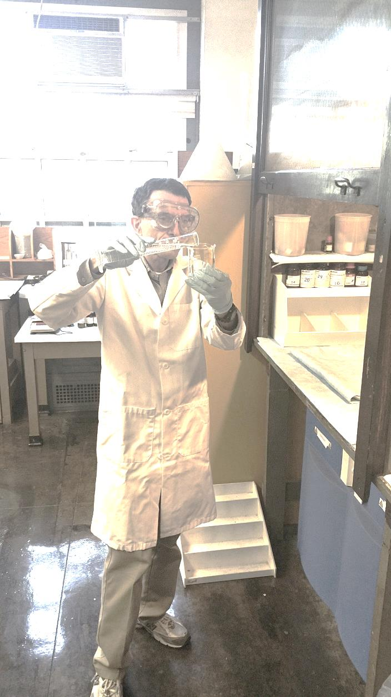
Exposure Control
Absorption: Protective Clothing
Also have to protect skin on other body parts
Researchers have been injured:

Slide 35
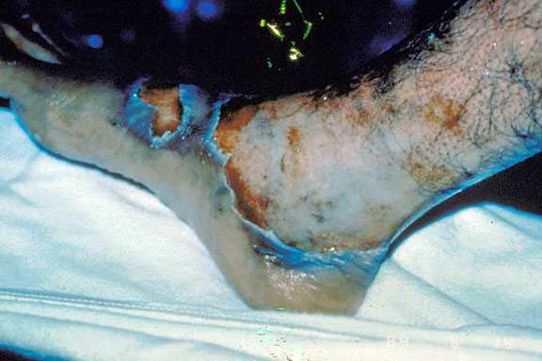
Prevent Absorption
Sodium Hydroxide

Slide 36
Exposure Control
Proper Lab Attire
Lab coat
Pants or longer skirts
Don’t wear too loose or too tight of clothing
Closed toe shoes (non-slip)

Slide 37

Exposure Control
Ingestion:
No mouth pipetting !!!
No eating, drinking or applying cosmetics in chemical use areas
Wash hands before leaving the lab
No food or drink storage in labs

Slide 38
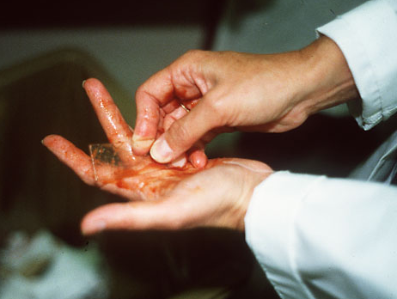
Exposure Control
Injection:
Don’t directly handle broken glassware, needles and other sharp objects

Slide 39
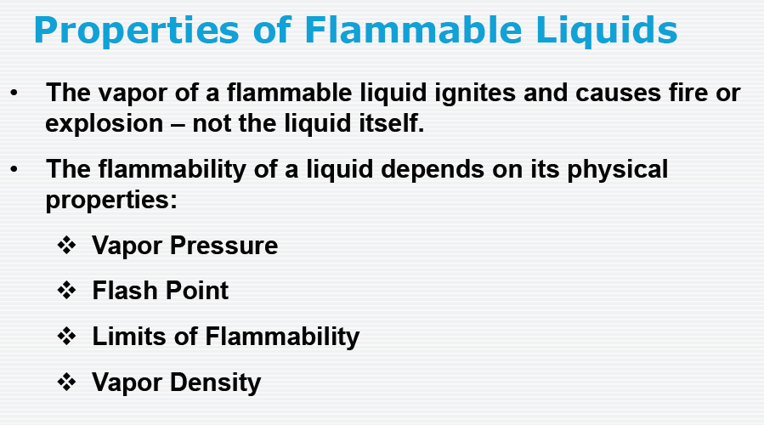

Slide 40
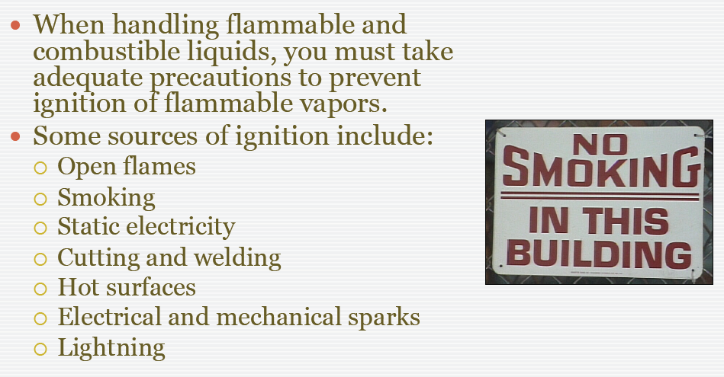

Slide 41
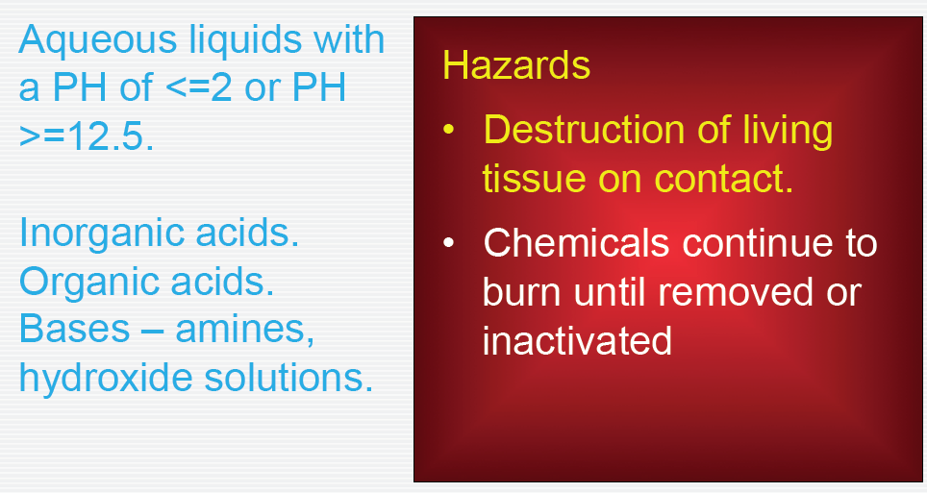
Corrosives

Slide 42
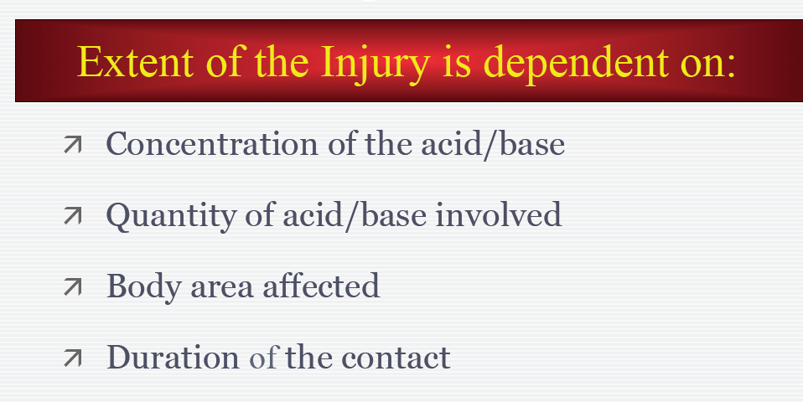
Corrosives

Slide 43
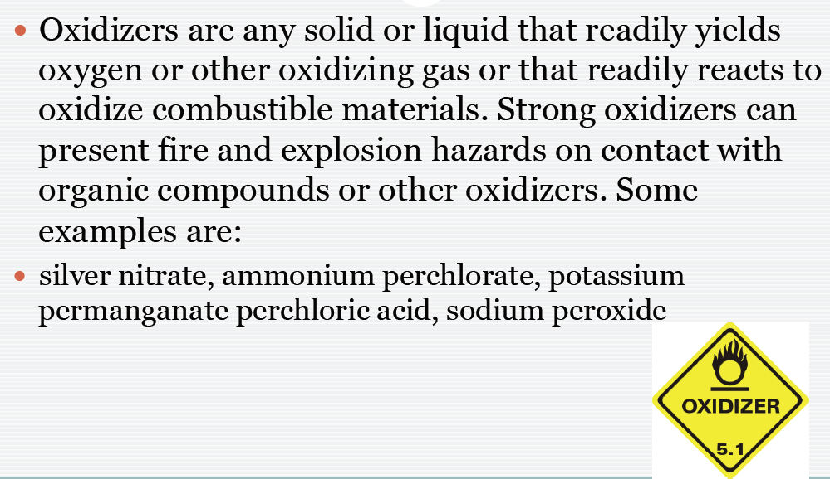
Oxidizers

Slide 44
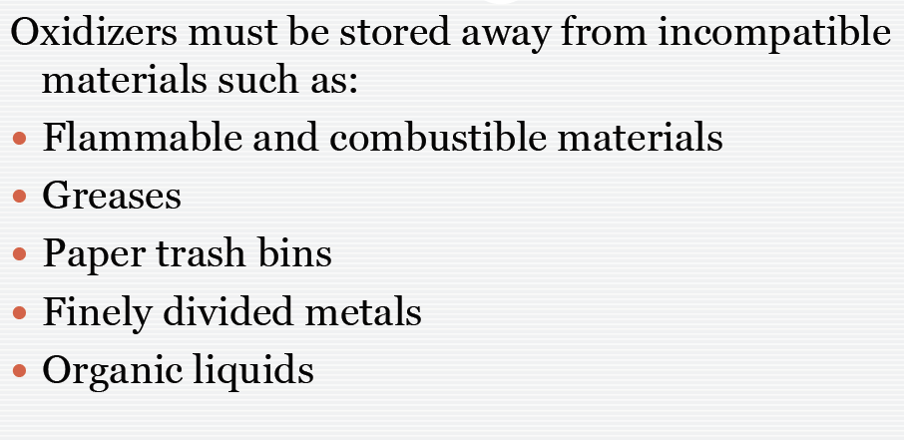
Oxidizers

Slide 45
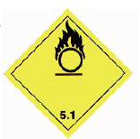
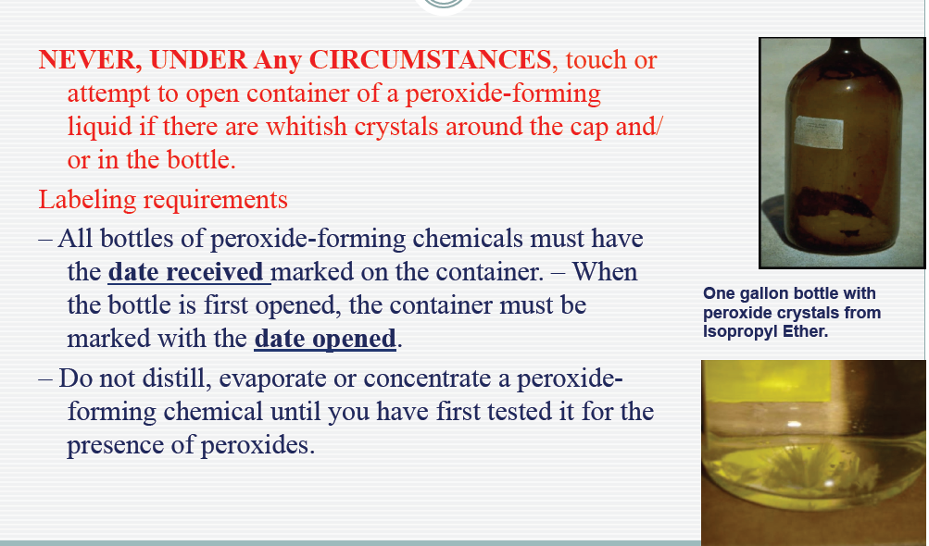
Peroxides

Slide 46
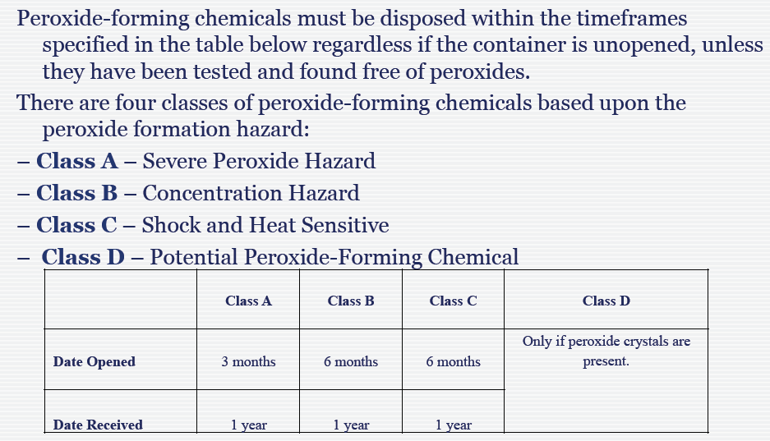
Peroxides

Slide 47
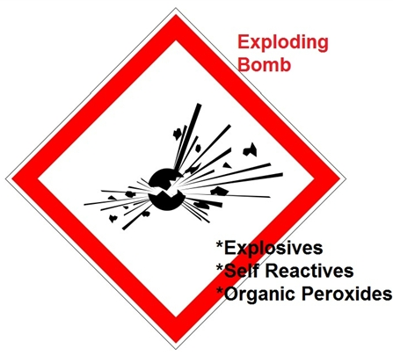
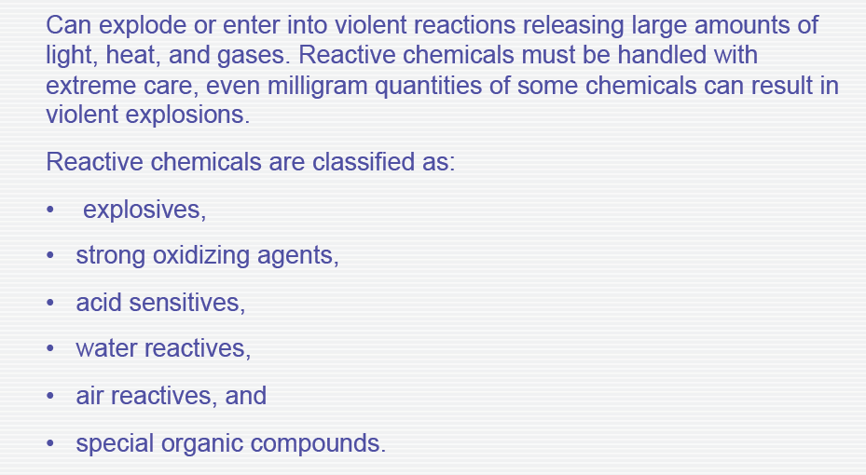
Reactive Chemicals

Slide 48
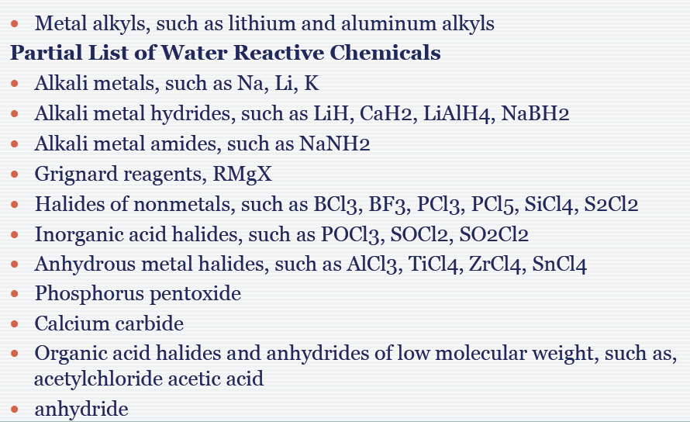
Water Reactive Chemicals

Slide 49
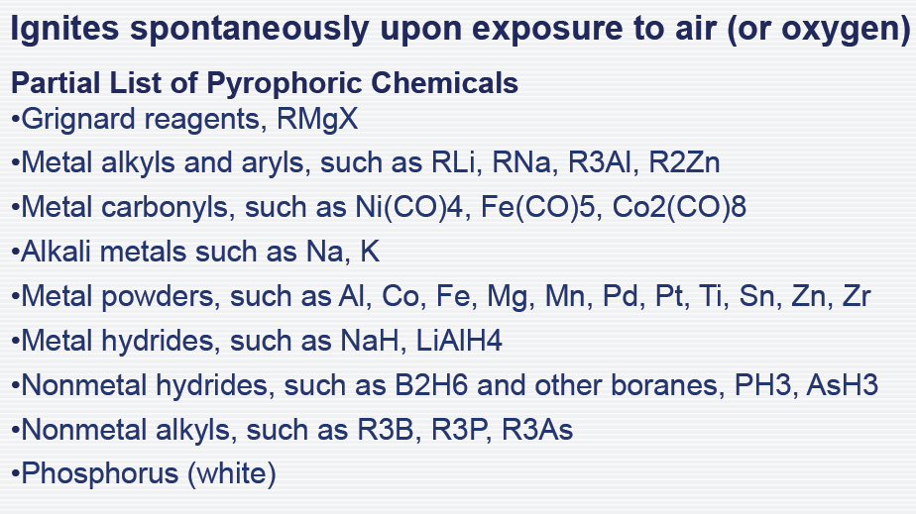
Pyrophoric Chemicals

Slide 50
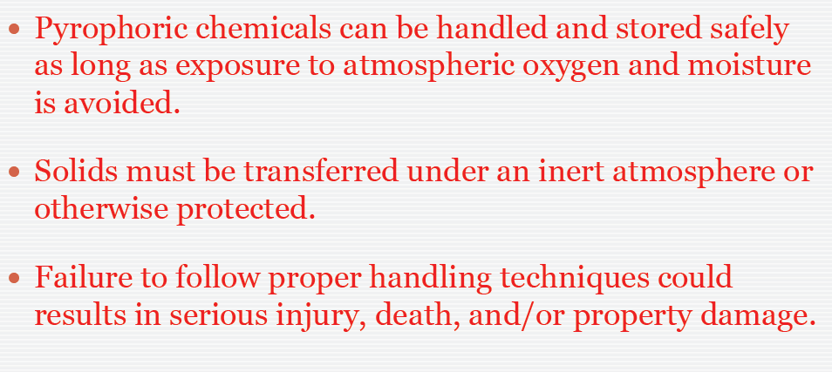
Pyrophoric Chemicals

Slide 51
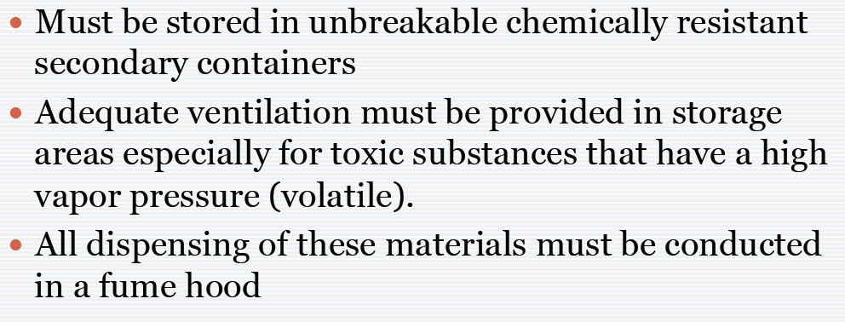
Highly Toxic/Particularly Hazardous Substances

Slide 52
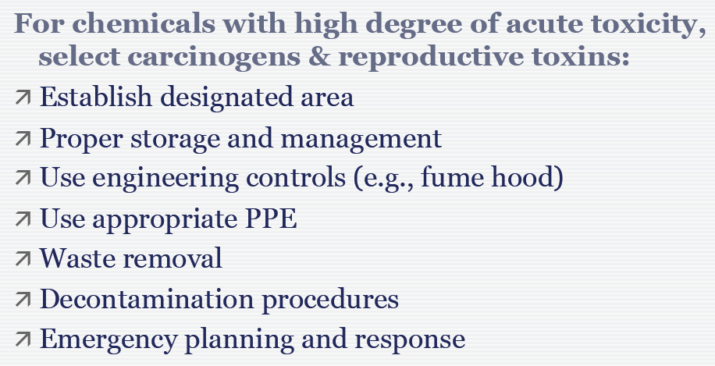
Highly Toxic/Particularly Hazardous Substances

Slide 53
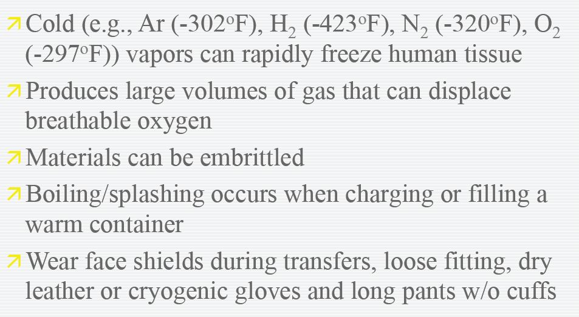
Cryogenic Materials

Slide 54

Natural Gas
If you suspect that there is a gas leak or smell of an egg like odor, then it may be a gas leak.
Gas is odorless and can be difficult to detect
Ensure lights are turned off
Evacuate the room or facility

Slide 55
Electrical Equipment
check all equipment for damaged and worn insulation on wiring
connect ground wires to clean metal
keep wires and other electrical equipment away from water & hot surfaces
avoid use of extension cords,(designed for temporary use only)
avoid homemade/makeshift wiring (use approved wiring methods)
never touch a switch/outlet with wet hands
do not use electrical equipment in a flammable atmosphere (I.e. electrical plug strip in a fume hood)

Slide 56
CHEMICAL STORAGE
Provide Lab Security
Keep the public from your chemicals
Systems already in place:
  Lock your lab when unattended
  Do not prop open building doors

Slide 57
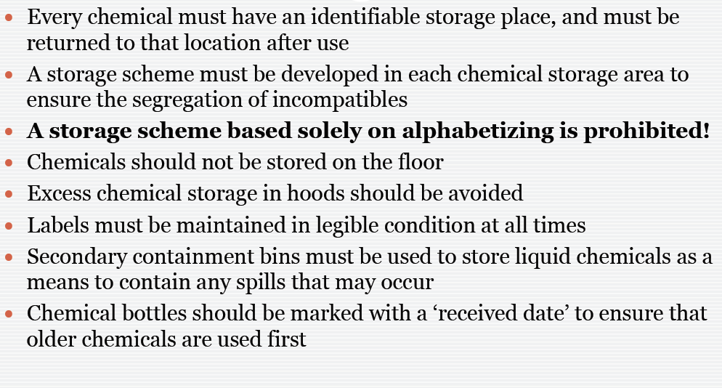
CHEMICAL STORAGE

Slide 58
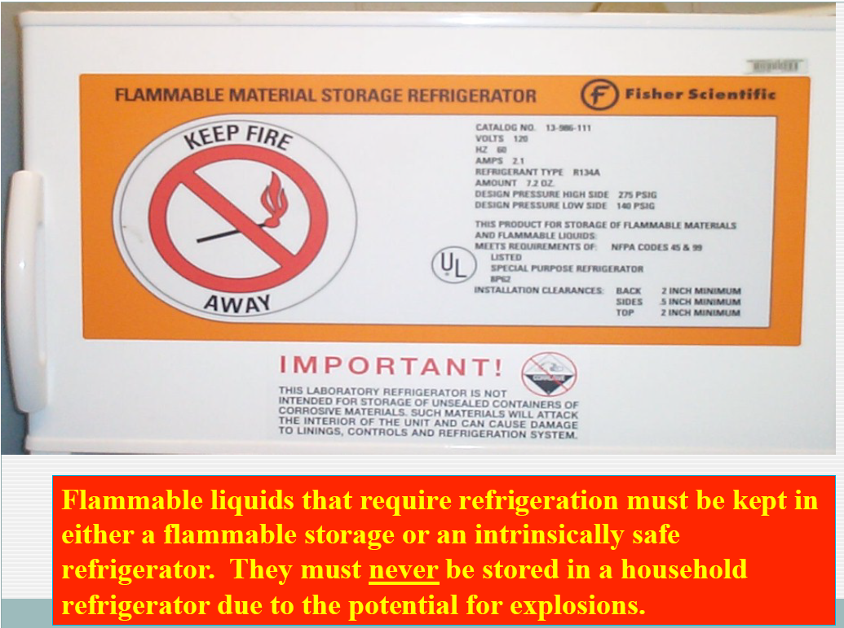

Slide 59
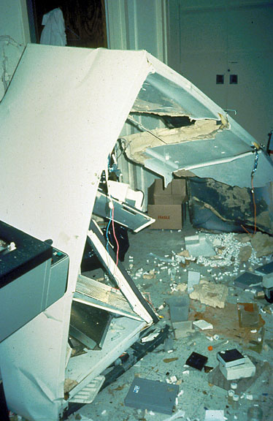
CHEMICAL STORAGE
Flammables
Refrigerators
  explosion proof
  flammables
  regular
1 gal of isopentane did this

Slide 60
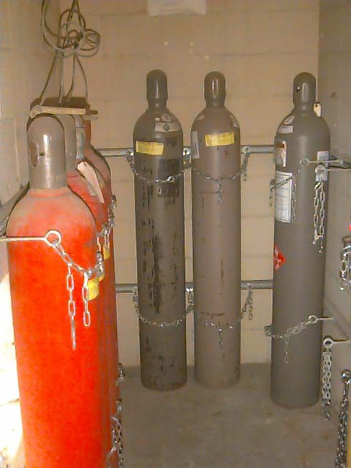
Compressed Gases
Properly secure at all times
  Straps, belts, or chains
Keep valve caps on unless the cylinder is being used
Store in a well ventilated area
  Keep away from heat or ignition sources
  Keep away from electrical circuits
Segregate Oxygen cylinders (empty or full) from fuel-gas cylinders and combustible materials
  20 feet minimum distance
Store flammable gas cylinders away from oxygen, nitrous oxide cylinders.
Segregate full and empty cylinders
  Label empty cylinders to prevent confusion
  Empty cylinders should be returned to Vendor

Slide 61
SHIPPING SAMPLES/CHEMICALS
All shippers (Fedex, UPS) will require you to state if a “Dangerous Good”
Determine if hazardous material
  Toxic, biohazard, corrosive, flammable
  Dry Ice. Compressed gasses (even air)
Proper packaging and labeling
  Use only specifically designed packages
Shipping papers signed by certified person

Slide 62
Identify Wastes
All chemical waste is treated as hazardous, except:
  Certain Buffer Solutions, Salts, Sugars and Amino Acids
  empty containers, 5 gallons or smaller, that did not contain acutely hazardous material (E.g.: acrolein; see website)
Mixed waste
  biohazardous + chemical ⇒ chemical waste
    Deactivate any biological organisms
  radioactive + chemical ⇒ “call EH&S first”
    Short half-life preferred (32P)
    Treat the chemical portion

Slide 63
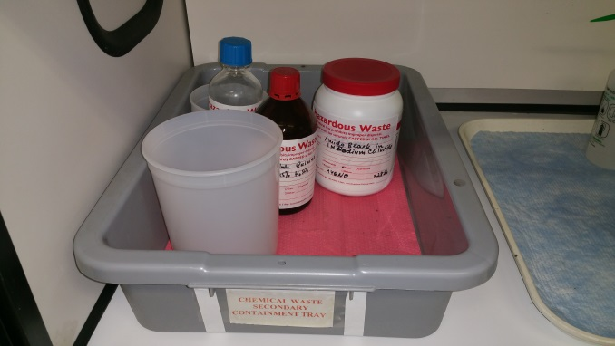
Hazardous Waste Disposal
Each lab has a Satellite Accumulation Area
  Waste from your lab only
  Proper segregation
  Secondary containment
  Proper labeling
  Max of 50 gallons total/1 quart of acutely hazardous waste
  FDNY Lab Permit storage limits
  Everyone with access must be
  trained

Slide 64


Prohibitions
Illegal Disposal
  don’t put in a drain or trash
  don’t intentionally evaporate
Transportation
  EH&S will pick the waste up
Treatment without EH&S approval

Slide 65
Most Common (and fineable) EPA Violations
  Improper labeling of waste
  Improper segregation and compatibility of waste
  Improper storage of waste
  Failure to remove funnel & cap waste bottles
  Accumulation of excessive waste

Slide 66
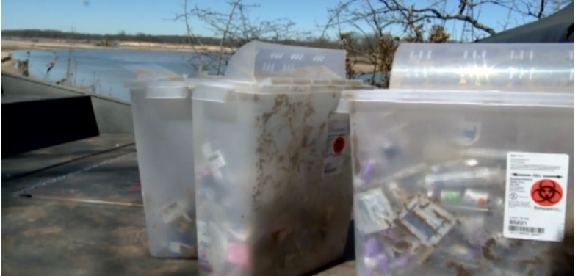
Regulated Medical Waste
www.Cnn.com
Infectious animal waste
Human pathological waste
Human blood and blood products
Needles and syringes (sharps)
Cultures and stocks (microbiological materials)
Other biohazard waste (e.g. materials contaminated with infectious agents such)

Slide 67
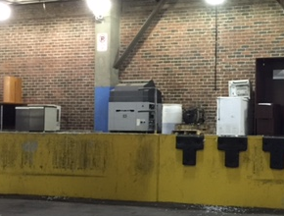
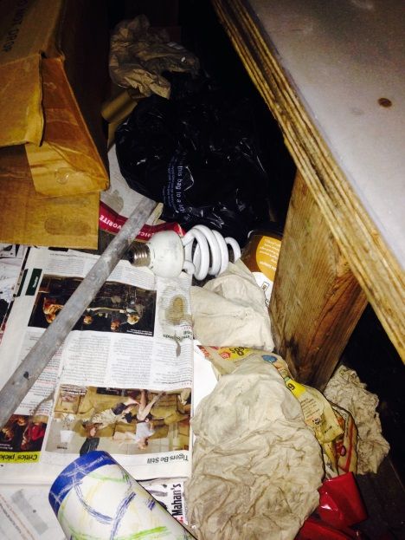
DISPOSE: “Universal Wastes”
Fluorescent Tubes
Batteries
Electronic Equipment

Slide 68

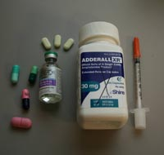
Radioactive Waste
Obtain NYC License
Notify EHS & Radiation Safety Committee
Obtain individual DEA license
Contact EHS
Controlled Substances Waste

Slide 69
Chemical Spill
Clean-up small spills if you:
Do not clean-up a spill if you:
Have materials to absorb and bag the spill
Are familiar with the material’s properties
Have the proper personal protection
Know spilled acids or bases are dilute
Don’t know the identity of the chemical
Lack the knowledge to safely handle the spill
Feel the spill is unsafe to clean up
Don’t have the materials at hand
Were exposed or injured by the spill

Slide 70
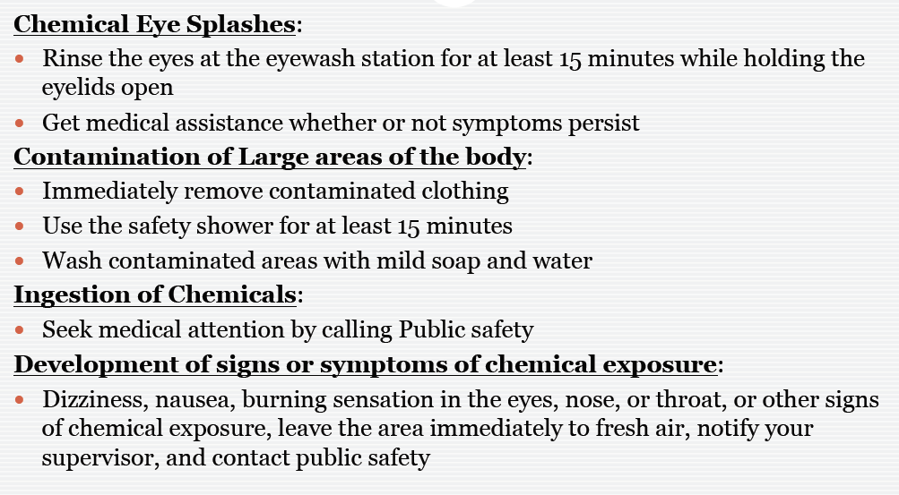
Chemical Exposures

Slide 71
Chemical Exposures
Reporting:
For all incidents, fill out a “Laboratory Incident Report”
(App A in Chemical Hygiene plan)
Complete workers comp packet as appropriate

Slide 72
https://www.youtube.com/watch?feature=player_detailpage&v=ktrv34zW7-A
The P.A.S.S. Method
Aim the hose
or nozzle.
Pull the pin.
Squeeze the lever.
Sweep the
agent.
Notes:
Knowing how to use the Fire Extinguisher is a critical step in knowing whether to fight or leave.
P.A.S.S. is the method for PFE use. This series of letters gives quick operating instructions for the widely available types of extinguishers.
To use the PFE:
1. PULL the pin that keeps the extinguisher from
accidentally discharging.
2. AIM the hose or nozzle at the base of the fire so
the agent is discharged onto the burning fuel.
3. SQUEEZE the operating lever which is positioned as
part of the "handle".
4. SWEEP the hose or nozzle back and forth, so the
agent is spread over all of the fuel. Continue to
discharge the agent until the the extinguisher is
empty and the fire is out.

Slide 73
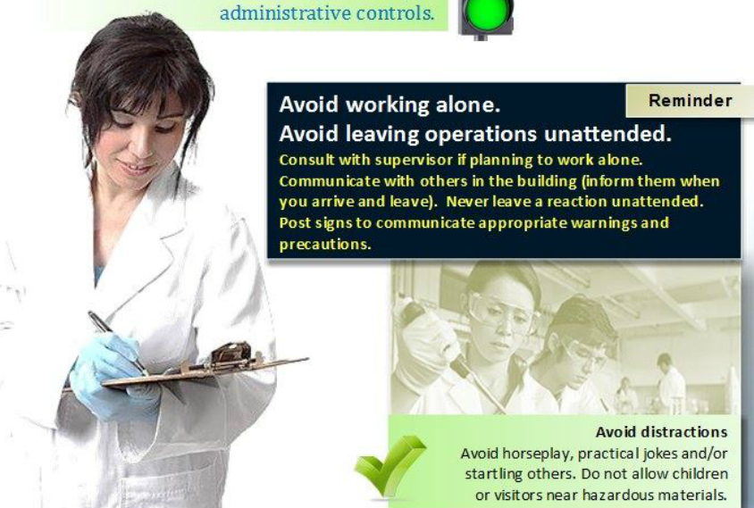

Slide 74
Chemical Safety Board Video: Experimenting with Danger

