Slide 1

York College Excelsior Scholarship
Workshop
Notes:
In Slide Show mode, select the arrows to visit links.

Slide 2


Excelsior Scholars

Slide 3
Excelsior Scholarship Pre-Evaluation
Your input is important as we work to continuously improve the Excelsior Scholarship at York College. Please take a moment to complete the pre/evaluation
Excelsior Workshop Pre-Evaluation
https://www.york.cuny.edu/advisement/excelsior-scholarship/-excelsior-scholarship-workshop/york-college-excelsior-scholarship--pre-evaluation-

Slide 4
Workshop Agenda
Learning Objectives
Overview of Excelsior Scholarship - HESC
Maintaining Academic Eligibility
Connect and Communicate
Completion Coaching Sessions
    (1:1 Scholarship Specialist Appointment)
Questions

Slide 5
LEARNING OBJECTIVES
By the end of the workshop, you will be able to:
Recognize the academic requirements of the Excelsior Scholarship
Understand the communication timeline for Excelsior Scholarship recipients
Locate the support services available to help you succeed and stay on track
Identify strategies to help you stay on track and persist towards timely graduation
Access the academic support available through Completion Coaching Sessions
Use the Excelsior Scholarship websites as a resource

Slide 6

Overview of Excelsior Scholarship - HESC

Slide 7
Eligibility- HESC
Academic Requirements
An applicant must:
be enrolled in at least 12 credits per term and complete at least 30 credits each year (successively), applicable toward his or her degree program through continuous study with no break in enrollment except for certain reasons that can be documented
if attended college prior to the 2021-22 academic year, have earned at least 30 credits each year (successively), applicable toward his or her degree program prior to applying for an Excelsior Scholarship

Slide 8

Excelsior Application – HESC
You do not have to apply for Excelsior every semester, however you do need to apply for FAFSA and TAP every academic year.
According to HESC: To receive award payments after the initial application year, an Excelsior Scholarship recipient must annually complete the Free Application for Federal Student Aid (FAFSA) and the NYS Student Aid Payment Application each year.

Slide 9
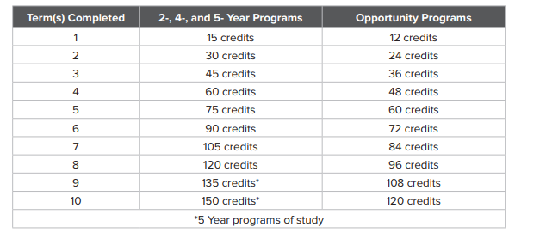
Duration of the Scholarship - HESC
How long can you receive the Excelsior Scholarship?
The Excelsior Scholarship program is designed to encourage students to earn their college degrees on time
You are eligible to receive Excelsior Scholarship for up to:
2 years for students pursuing an Associate’s degree.
4 years for students pursuing a Bachelor’s degree.
Students in an undergraduate program of study normally requiring 5 years are eligible to receive the award for 5 years (SEEK)

Slide 10
Credit Accumulation- HESC
Academic Requirements
Credits may be earned from any term during the academic year (includes summer and winter sessions) NOTE: (No Excelsior funds for these terms)
Exceptions made for students with disabilities under the ADA
Student with disability required to complete attempted credits each semester
Earn a passing grade established by the institution

Slide 11

Credit Accumulation- HESC
Do the college credits earned in High School (College Now and AP classes) count toward the thirty (30) credit requirement?
CUNY College NOW, Advanced Placement (AP), International Baccalaureate (IB), etc.
Any non-matriculated college credit that is transferred into SUNY and CUNY can be used to help students meet their annual 30 credit requirement
Credits may be “banked “ to use in future academic years

Slide 12
Transfer Students- HESC
Can I get an Excelsior Scholarship award if I’m a transfer student?
A student who transferred between colleges is eligible for an Excelsior Scholarship provided they do not have a break in enrollment and are on track to complete their Associate’s degree in 2 years or their Bachelor’s degree in 4 years based on the number of credits accepted by their current college.
If you are a transfer student whose current college did not accept all your credits and you are no longer on track to complete your degree on time, you will be ineligible to receive an Excelsior Scholarship

Slide 13

Loss of Excelsior Scholarship - HESC
Students who do not successfully complete thirty (30) credits in their program per year can lose the scholarship.
Students who fail to complete 30 credits at the end of the year will be able to keep their award for the first term, as long as they attempted to 12 credits or more. Students will not be eligible for the scholarship in their second term.
If a student loses their award for not meeting the annual 30 – credit requirement, then they cannot regain eligibility as they are no longer on-track to graduate on-time.

Slide 14
Appeals
Students who are determined to be ineligible for failure to meet the annual credit or continuous enrollment requirements and who can demonstrate good cause may appeal the decision by completing and submitting the Excelsior Scholarship Program Appeal Form to Excelsior.Appeals@hesc.ny.gov.
If you have further questions, please contact the Excelsior Scholarship Unit at scholarships@hesc.ny.gov or 888-697-4372.

Slide 15
Excelsior Scholarship – York College
Staying on Track
Students Who Become Ineligible to Receive Excelsior Scholarship for the Following Year
Semester | Award Year | Not Eligible
Fall | 2017 | 29
Spring | 2018 | 108
Fall | 2018 | 21
Spring | 2019 | 91
Fall | 2019 | 21
Spring | 2020 | 83
Fall | 2020 | 23
Spring | 2021 | 57
Data indicates that the primary reason students at York College who receive the Excelsior Scholarship become ineligible is because they are not on track academically to complete their degree within 4 years.
These students did not complete 30 credits within the academic year (365 days)
The chart shows a significantly higher number of students become ineligible to receive the Excelsior Scholarship for the award years beginning in the spring
What are some other reasons students become ineligible for Excelsior?

Slide 16

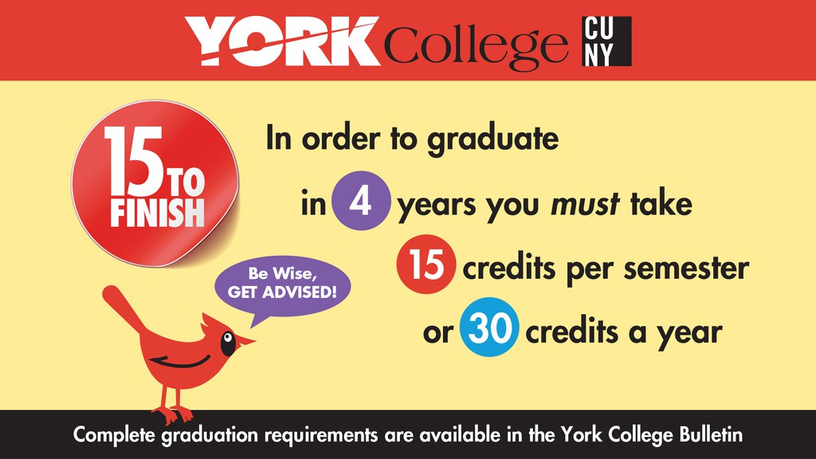

How do You Maintain Eligibility?
Finish in “4”
12 credits/semester = full time
15 credits/semester|30 credits/ year = on-time graduation.
At CUNY, it doesn’t cost more to take 15 vs 12 credits
30 credits/year
increased eligibility for the full-tuition Excelsior Scholarship
maximizes NYS TAP awards
  both limited to 8 semesters (4 years)

Slide 17

How do you maintain eligibility?
.
You can catch up on missing credits during the summer and winter sessions.
Example:
Fall (15crs -12crs with/Winter)
  Winter (pay out of pocket)
Spring (15crs -12crs with/Summer)
  Summer (pay out of pocket)
OR
Spring (15crs -12crs with/Summer)
  Summer (pay out of pocket)
Fall (15crs -12crs with/Winter)
  Winter (pay out of pocket)
Catching up on Credits

Slide 18
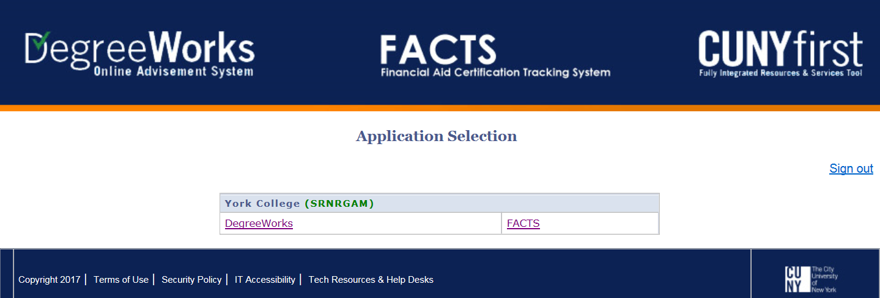
Systems/Platforms to track your academic progress
Tracking your Degree Progress
DegreeWorks: Degree Audit (BB tutorial)
FACTS: Financial Aid Certification Tracking System (FACTS)
  Current Eligibility > Summary > Details

Slide 19
Review
Students must enroll for at least 12 credits per semester and complete 30 credits per year.
Students are strongly encouraged to register for 15 credits per semester to maximize their ability to retain eligibility for the program and on-time graduation.
AP/IB and other credits earned in high school can be “banked” and may be used to meet the annual 30-credit requirement.
Only transfer credits accepted towards the current college/degree will count towards Excelsior requirements.
Once eligibility is lost due to academic reasons, it cannot be regained.
Students can use credits earned during winter or summer to meet the 30 credits per year requirement.
Students who change their major may continue to receive Excelsior funding provided that the student remains on track for a 4-year graduation.
There is no specific GPA requirement for Excelsior, however students must remain in good academic standing.
A repeated course will only count once toward cumulative credits, therefore a student typically needs additional credits during the academic year they are repeating a course to meet the cumulative credit requirement for Excelsior.
Students are strongly encouraged to consult academic and financial aid advisors before withdrawing from classes, changing majors, or enrolling in courses that are not applicable to their degree.

Slide 20
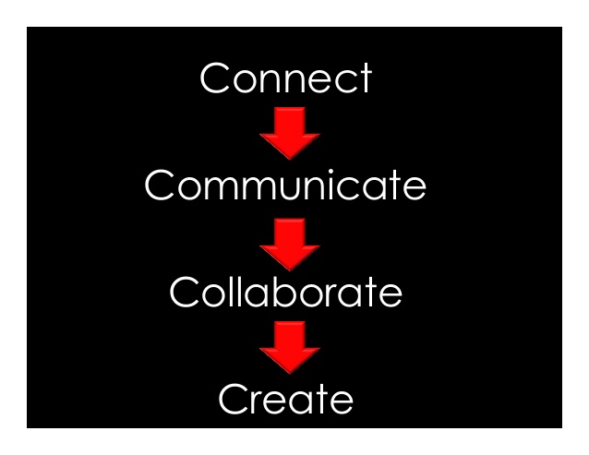
Connect and Communicate
Connect
  Excelsior Scholarship Liaison
  Academic Advisement Center Staff/Advisor
  Faculty Advisor
Communication
(Academic Year, Semester)
  Eligibility - updates
  Ineligibility - updates
Excelsior Scholarship Workshops
  Spring
  Fall
Completion Coaching Sessions
  1:1 Scholarship Specialist Appointment
    Student Educational Plans (SEP)
    Email Excelsior@York.cuny.edu

Slide 21
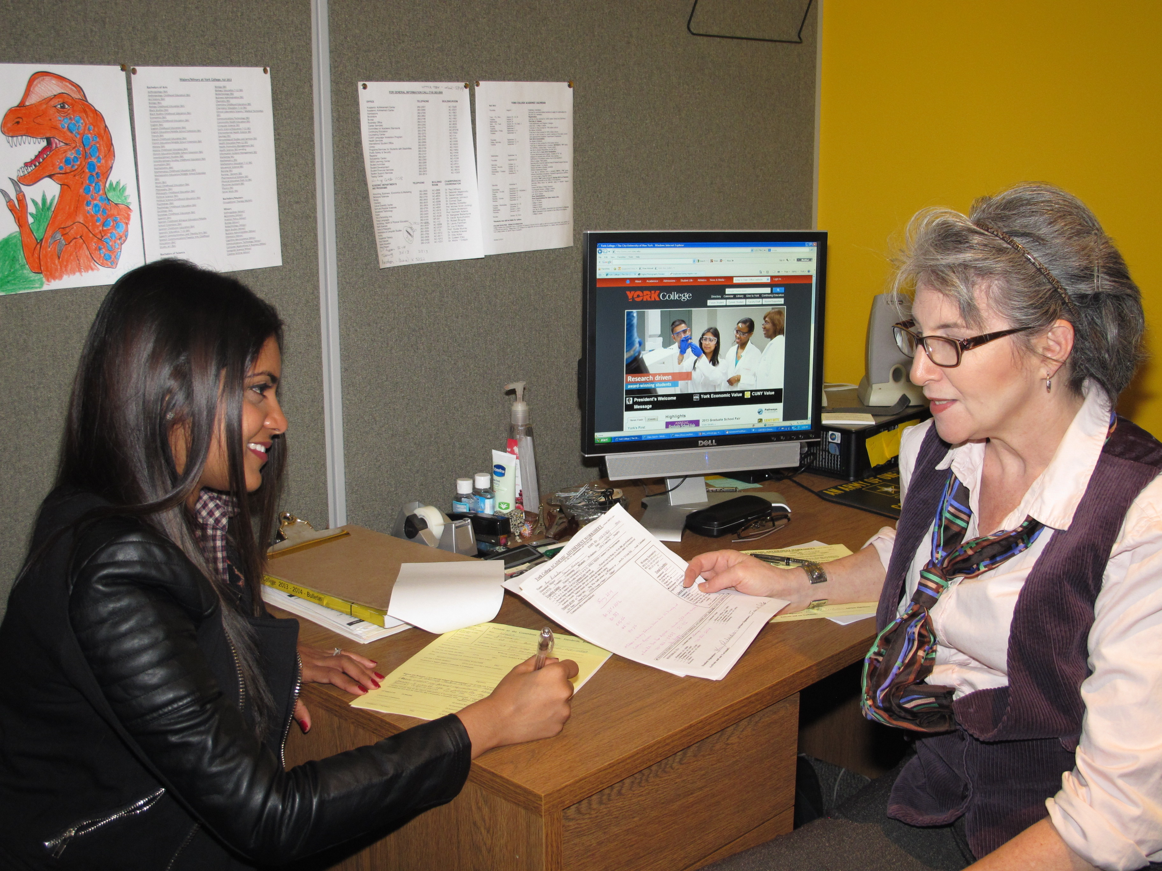
1:1 Scholarship/Advisement Appointment
1:1 Scholarship Appointment is an opportunity for you to check-in with the Excelsior Liaison and to provide you with additional support to stay on track
Success Coaching
Scholarship Status
Academic Progress
Program Challenges
Change of Major
Create/Review long-term educational plan
Engage in Major and Career Exploration

Slide 22
Spring 2022 Enrollment
Winter 2022 Registration begins November 8, 2021
Spring 2022 Registration begins November 10, 2021
    Notification to Schedule 1:1 Scholarship/Advisement appointment
      ADH Hold

Slide 23

Find out more about:
1:1 Scholarship Specialist Appointment
Email Notification (Yorkmail account)
Excelsior Email: Excelsior@York.cuny.edu
Excelsior Scholarship FAQs
CUNY FAQs
https://www.cuny.edu/financial-aid/scholarships/excelsior-scholarship-faqs/
Questions on Scholarship Award
York College Financial Aid

Slide 24


Slide 25
Excelsior Scholarship Post- Evaluation
Your input is important as we work to continuously improve the Excelsior Scholarship at York College. Please take a moment to complete the post/evaluation.
Excelsior Scholarship Post- Evaluation
https://www.york.cuny.edu/advisement/excelsior-scholarship/-excelsior-scholarship-workshop/york-college-excelsior-scholarship--post-evaluation-

Slide 26
Excelsior Scholarship Evaluation
Excelsior Workshop Evaluation
https://www.york.cuny.edu/academics/advisement/excelsior-scholarship/-excelsior-scholarship-workshop/excelsior-scholarship-workshop-evaluation-

