Slide 1
DegreeWorks 100
Online Advisement System Audit
August 2018

Slide 2
Introduction to DegreeWorks

Slide 3
What is DegreeWorks?
An advisement and registration tool
Web-based program that tracks your progress toward completing requirements for your degree
Organizes student academic record from CUNYfirst by category

Slide 4
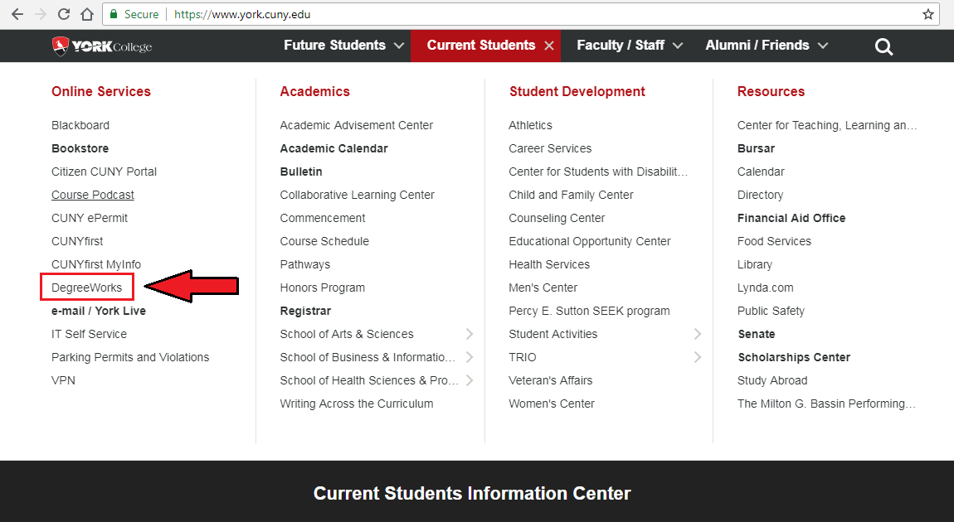
How do I access DegreeWorks?
www.york.cuny.edu > Current Students > DegreeWorks

Slide 5
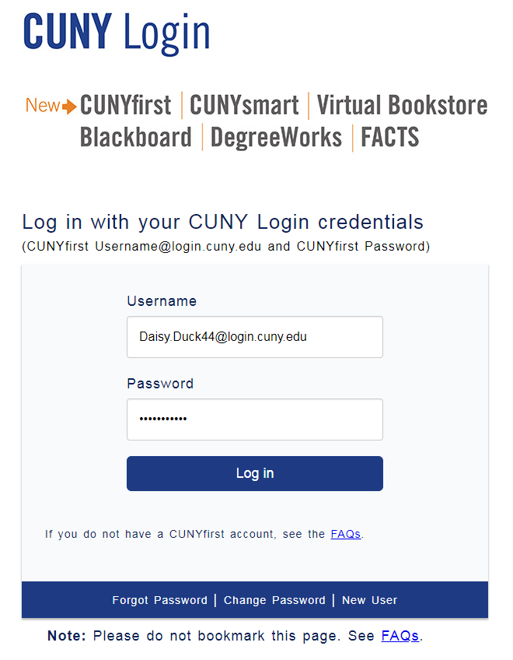
CUNY Login
CUNYfirst Username &
CUNYfirst Password
FirstName.LastName(last two digits of your EMPLID) @login.cuny.edu

Slide 6
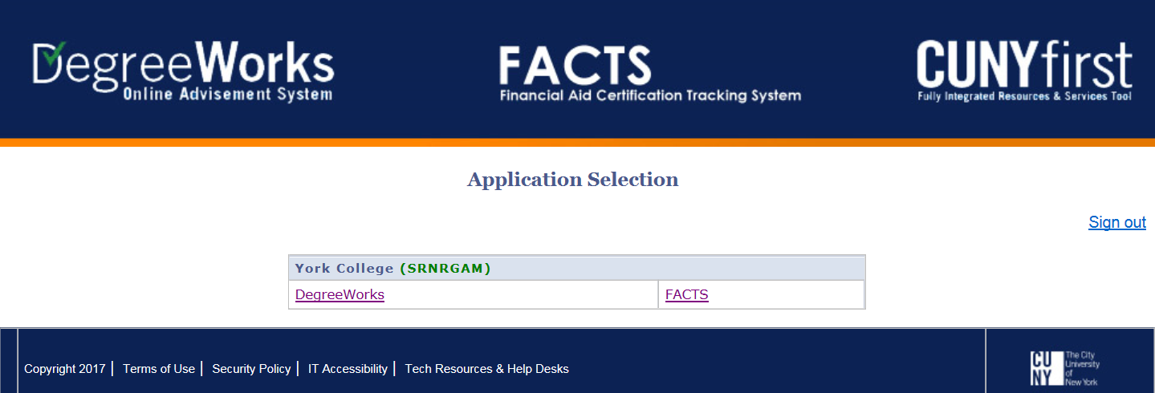
DegreeWorks Login
DegreeWorks: Degree Audit
FACTS: Financial Aid Certification Tracking System (FACTS)
Current Eligibility > Summary > Details

Slide 7
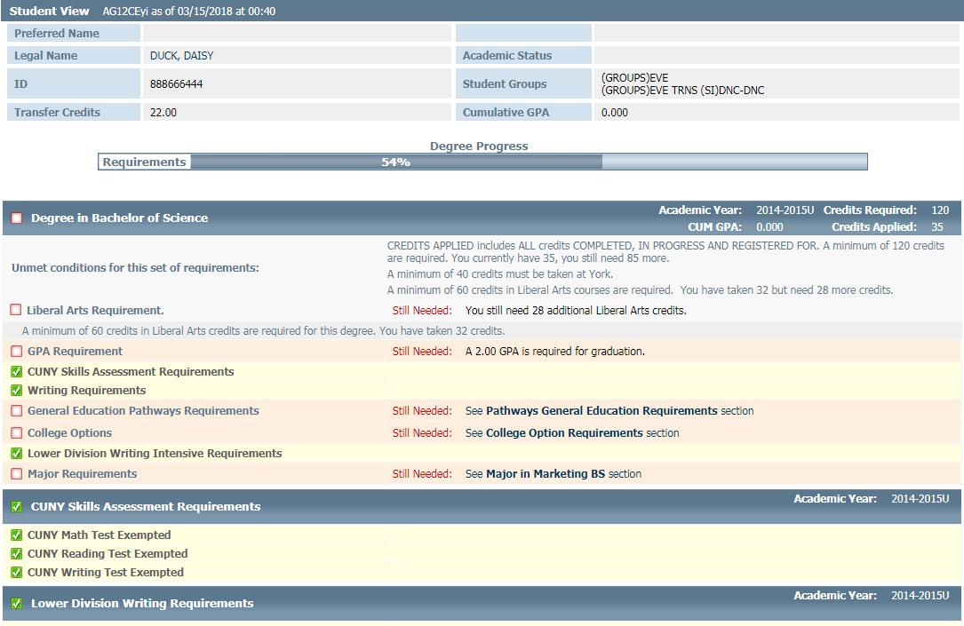
What does a DegreeWorks audit look like?
Sample Degree Audit

Slide 8
Legend
Requirement/course is completed
Requirement is not complete
In progress (course/requirement is in progress to being completed)
See Advisor (when student is nearing completion of a group of requirements, they are referred to an advisor for verification)
Wild Card indicates any course/extension number (i.e. ENG@=any ENG course; ENG 250@ = any ENG “Topics in Literature” course)
Transfer course from another college
Course a student is currently registered for (can be past, current or future semester)
: A colon between class numbers indicates a range of courses (i.e. SPAN 100:200 = any SPAN course number between, and including, SPAN 100 to SPAN 200)

Slide 9
Student View Area & Degree Progress
Student View Area is where you will find all your information
Degree Progress Bar is an estimation of your academic progress based on the number of completed areas (e.g. if you have not declared a major but completed all other areas your audit will show 100% complete)

Slide 10
CUNY Skills Assessment Requirements
Math, Reading and Writing Assessments should be completed upon acceptance to York
If any of these areas are not completed, meet with an Academic Advisor (AC-2C01 | 718-262-2280) or the Testing Office (AC-1G05 | 718-262-2012)

Slide 11
Credits Required vs. Credits Applied
Credits Required: Minimum number of credits needed to fulfill each area of your degree
Credits Applied: Sum of credits completed and in progress towards your degree requirements
Credits Required and Credits Applied can be found in multiple areas of your audit

Slide 12
Grade Point Average (GPA)
Cumulative GPA: average value of accumulated final grades earned in courses over time
Major GPA: average value of accumulated final grades earned only in the coursework required for your academic major

Slide 13
Writing Intensive Requirements
All students are required to complete 3 Writing Intensive courses*:
2 Lower Division (100-200 level) writing intensive courses, in any discipline
1 Upper Division (300 level or above) writing intensive course; usually in your major
Only the lower division requirement appear in this area

Slide 14
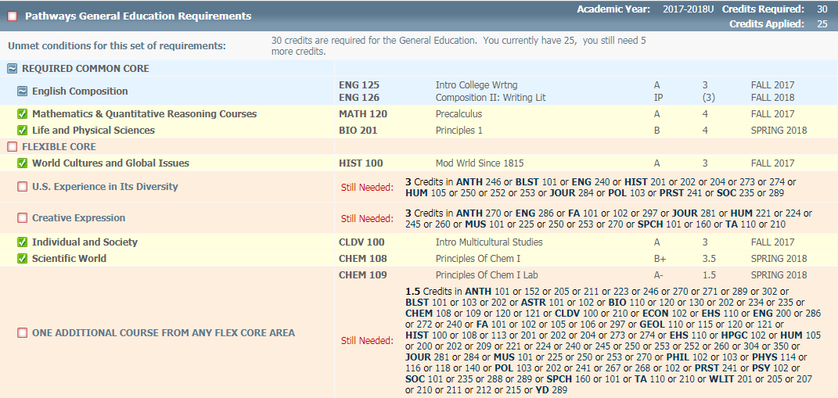
Pathways General Education Requirements
Also know as Common Core – Required and Flexible Core
Academic Year indicates matriculation or year of admission

Slide 15
College Option Requirements
12 Credits: For native students, transfers with 30 or fewer credits from a 2 year College, and transfers from any baccalaureate program without a degree
6 credits of foreign language*, HE 111 (3 credits), and 3 credits of either Writing Intensive (WI) (200-level or higher) or Writing 300-level (not WI)
9 Credits: For students who enter York College with more than 30 credits, but without an Associate’s Degree from a 2-year College
6 credits of foreign language* and 3 credits of either Writing Intensive (WI) (200-level or higher) or Writing 300-level (not WI)
6 Credits: For students who enter York College with an Associate’s Degree - AA, AS, AAS
2 courses of either 2 Writing Intensive (WI) (200-level or higher) or Writing 300-level (not WI) and 1 Writing Intensive (WI) course at the 200-level or above
Students with a prior Bachelor’s Degree are exempt from all College Options.
* Foreign Language courses must be in the same language.

Slide 16
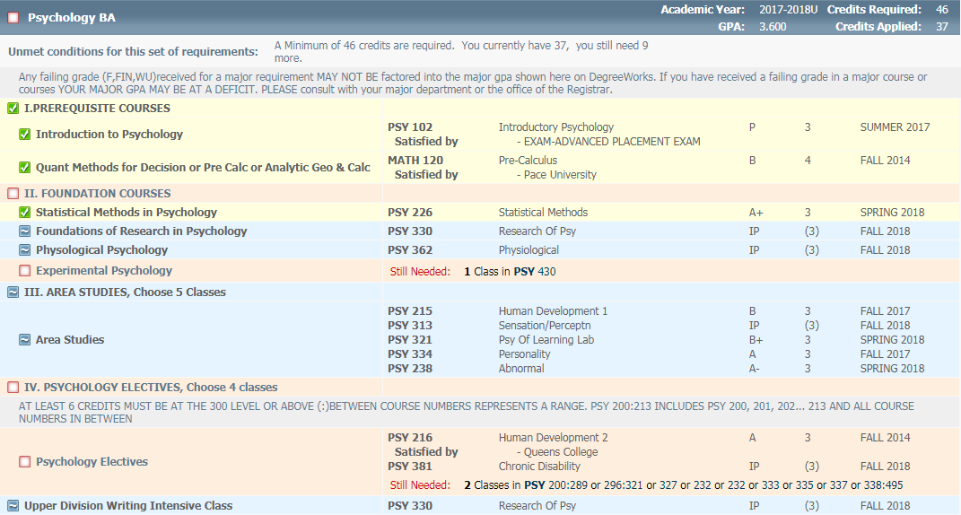
Major/Minor Requirements
Academic Year can be different from the year you matriculated
Based on the academic year you declared your major
Check with your advisor if you need clarification

Slide 17
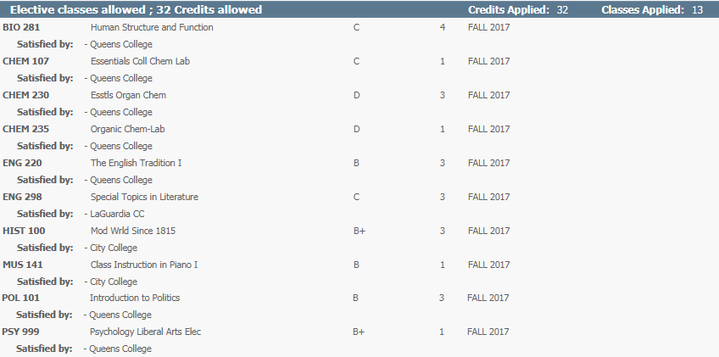
Elective Classes Allowed
Also known as Free Electives
Elective Classes are classes that are added to the 120 credits you need to graduate
Elective Classes can be from any discipline

Slide 18
Electives Classes Not Allowed
Electives Classes still count towards your degree and total credit count
Courses that exceed the number of credits for Elective Classes Allowed or do not apply to any requirement will fall down to this section
Courses that appear in this area can affect a student’s financial aid eligibility

Slide 19
Insufficient Grades
Courses that were not successfully completed
Grades of NC, W, WU, WD, F, FIN will appear here

Slide 20
In-Progress
Summary of all the courses you are currently registered for (including future semesters)
Information from CUNYfirst will appear on your DegreeWorks audit within 48-72 hours.

Slide 21
Notes
Faculty and Advisors can add notes to your audit to remind you of an action item.
Notes can also be a form of communication for offices on campus.

Slide 22
Disclaimer
To remind students that DegreeWorks is an advisement and registration tool
It is not an official transcript

Slide 23
What If
Explore how your academic requirements might change if you were to change your major
Coursework can be applied toward another major, minor, certificate or major concentration
What-If audits are not saved in the DegreeWorks system
What-If function does not officially declare and/change your major
If you would like to change your major, consult with an academic advisor (AC-2C01 | 718-262-2280)
If you would like to change, add, or declare a major and/or minor, visit the Office of the Registrar
(AC-1H08 | 718-262-2145).

Slide 24
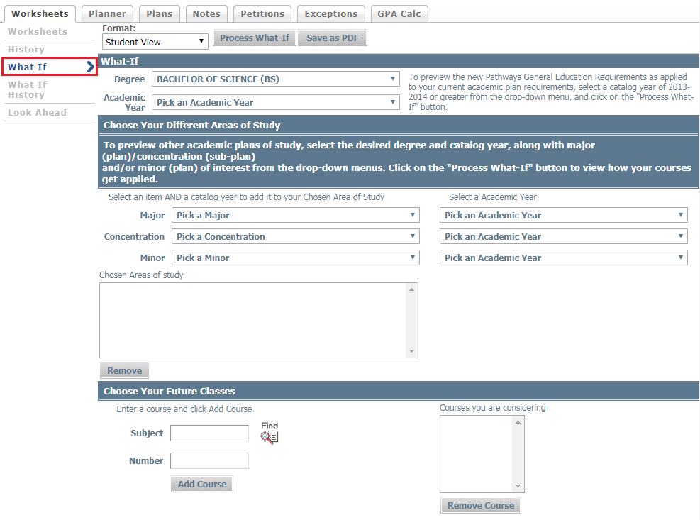
What If
What-If function is located on the left menu

Slide 25
What If
Select type of Degree and Academic Year you matriculated at York College

Slide 26
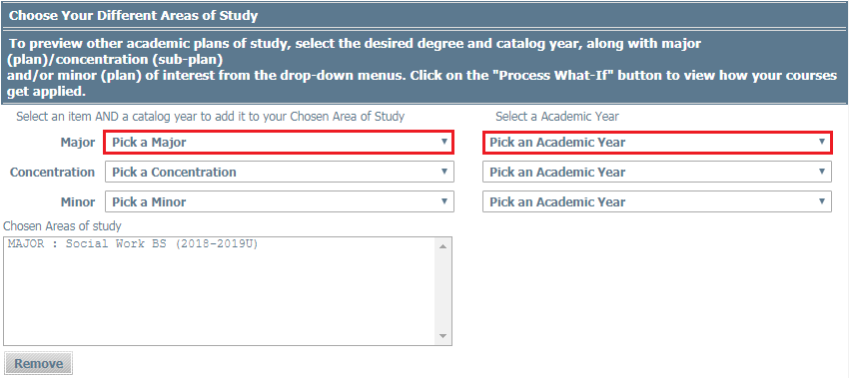
What If
From the drop down menus, select a major and academic year.
Your academic year is determined by the academic year you declare your major. This can be different from the academic year you entered the College.

Slide 27
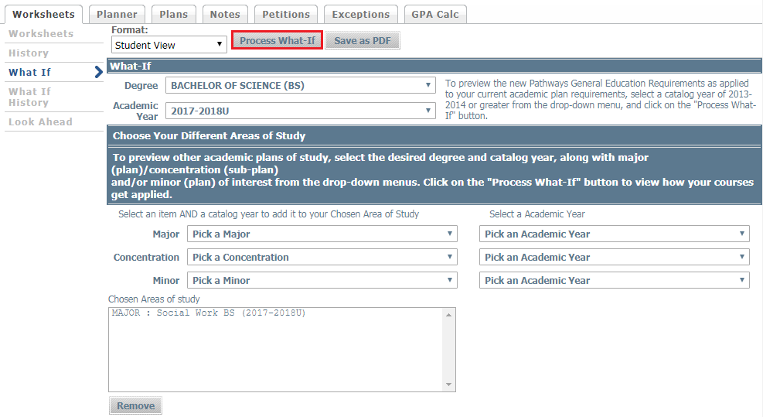
What If
Click ‘Process What-If’ to view your What-If audit
You can view multiple what-ifs to compare majors and minors

Slide 28
What If
On the left menu, click on ‘Worksheets’ to return to your audit

Slide 29
GPA Calculators
Three different GPA Calculators:
Graduation Calculator
Realistic goal-setting at the beginning of the term or academic career
Term Calculator
Calculation of end-of-term GPA using a student’s actual academic information
Advice Calculator
Accurate mapping of a student’s path for achieving honors, avoiding probation, or satisfying personal academic aspirations
NOTE: The GPA calculators are estimates. These GPAs are NOT official.

Slide 30
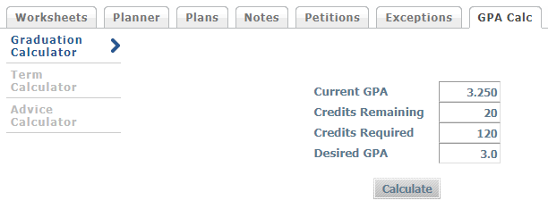
Graduation Calculator
The purpose of this calculator is to give students a general view of what average GPA they will need to achieve over their final “X” credits in order to reach their desired GPA.

Slide 31
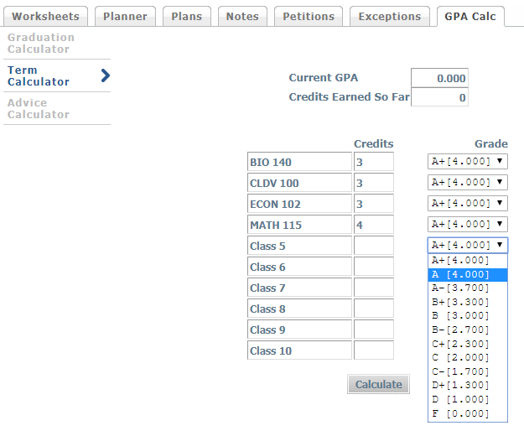
Term Calculator
This calculator is used to determine how different grades in currently enrolled courses could impact an overall GPA.

Slide 32
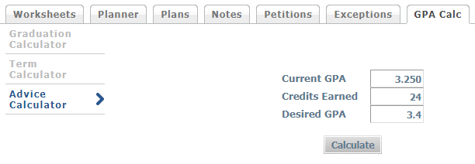
Advice Calculator
This calculator is used to figure out how to plan to raise an overall GPA. The advice that is displayed is based on credits and grades needed to achieve the desired GPA.

Slide 33
Remember, DegreeWorks is not…
An official/unofficial transcript
Student can easily view their unofficial transcript via CUNYfirst
Students can request an official transcript from the Office of the Registrar (AC-1H08 | 718-262-2145)
https://www.york.cuny.edu/registrar/transcripts

Slide 34
Academic Advisement
DegreeWorks does not replace meeting with a professional Academic Advisor
Students are encouraged to meet with their advisor every semester to track their progress, ask questions and obtain clarification about their DegreeWorks audit
Bring a copy of your audit to review with your advisor
If you see an error or discrepancy on your DegreeWorks, visit the Academic Advisement Center website to submit a request: https://www.york.cuny.edu/academics/advisement
NOTE: Information from CUNYfirst will appear on your DegreeWorks audit within 48-72 hours.

Slide 35
Thank You!
DegreeWorks Presentation Evaluation
Q & A

