Slide 1
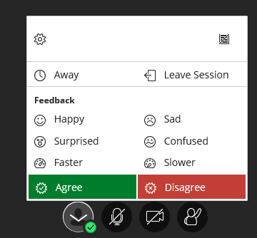
Click this button to check your audio level, upload an avatar, etc.
Click this button to raise your hand if you want to speak. Click again to lower your hand.
Click this button to choose your feedback: agree, disagree, confused, etc.
Click this button to unmute or mute your microphone. It is a best practice to only unmute it when you want to talk in the class.
Click this button to unmute or mute your video. To make the connection for everyone faster, mute your video.

Slide 2
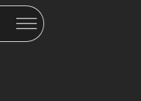
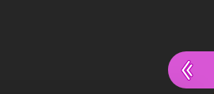
Click the purple button with double arrows at the bottom right to open the Collaborate panel where you can access the Chat panel, test your audio and video, and add an avatar.
Click the 3-line session menu on the top left to find dial-in pone number for audio in case your microphone doesn’t work.
You will also click on this icon when you leave the session after the class is over.

Slide 3
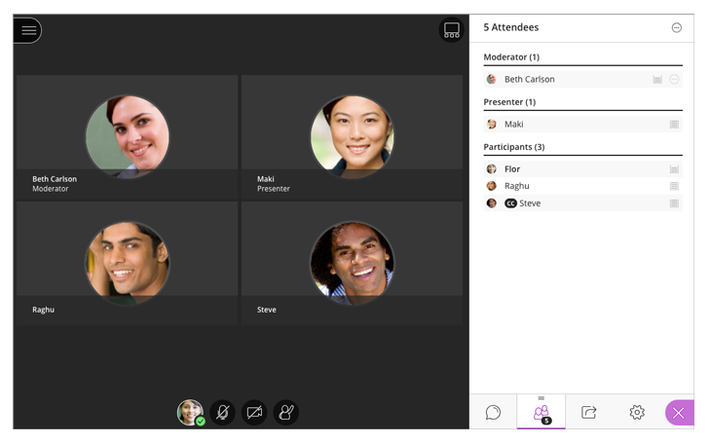
Click to test audio, video, and change settings.
Click to access attendee list
Click to access Chat panel
Click to access Share Content panel

Slide 4
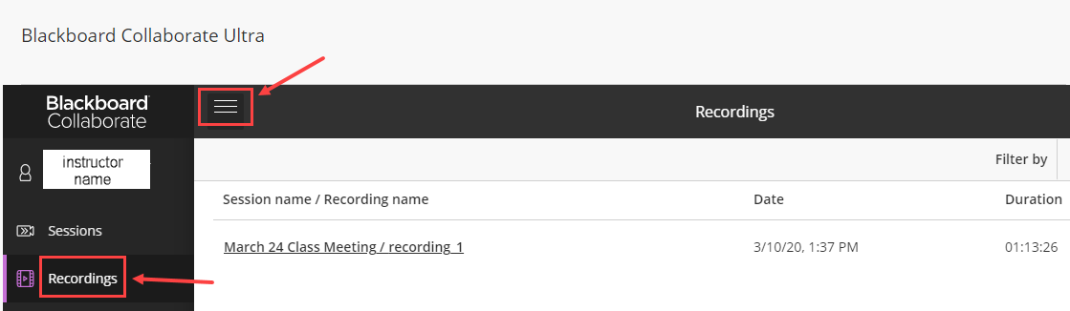
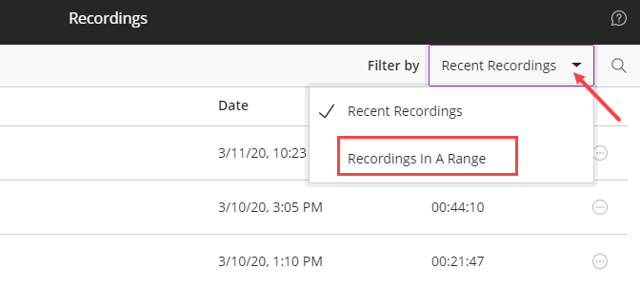
Where are the recordings?
1
2
By default, the recording page list the recording of the sessions conducted recently. To access the recordings for earlier sessions, click the dropdown and choose “Recordings in a Range” and select the date interval.

