Slide 1

FY 2026 College Budget Town Hall Presentation
October 3, 2025

Slide 2
FY 2025 Year-End and 2026 Financial Plan

Slide 3
FY 2026 Financial Plan
Key Assumptions:
Tuition Revenue: 2% tuition rate increase and a 1% year-over-year growth in collections; prior year collections rose from $1.8M to $2.2M.
NTL Support: Maintained at $1.85M.
Adjunct Budget: Held at FY25 level of $8.75M, with additional funding for CBA retroactive pay and contractual increases.
Temporary Staff: 10% budget reduction, bringing the total to $3.2M.
OTPS: Reduced to $4M, reflecting an additional $500K cut.

Slide 4
FY 2026 Q1 Financial Plan Update
Changes to FY 26 FP:
Total Resources increase by $10.49M, comprised of:
$9.6M for PSC CBA-related costs
$$890K in additional allocations for programs and special initiatives (Project Serve $127K, Midwifery allocation $350K, Few initiatives roll forward from FY25 $200K, PS Year-End support $104K, and few new initiatives)
Total Projected Expenditures increase by $9.6M, primarily to account for:
PSC CBA increases
Retroactive payments
Contractual bonuses

Slide 5
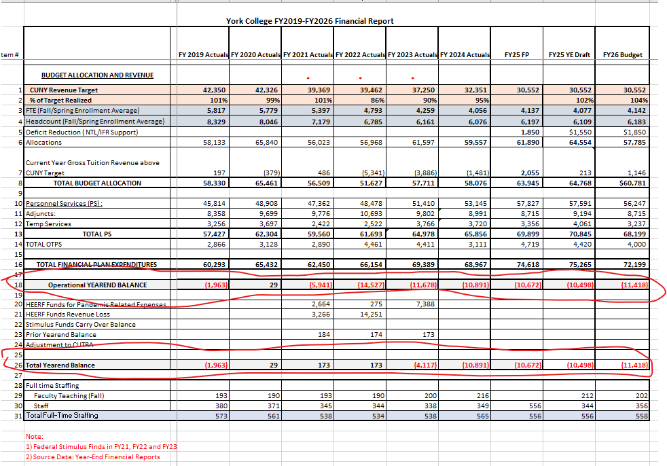
York College FY2019-FY2026 Financial Report

Slide 6
Revenue Generating Ideas and Discussion
Revenue Generating:
Auxiliary Income
Work Force Development / Continuing Education
Enrollment Increase
Fundraising
Grants
Revenue Generating Ideas and Discussion

Slide 7
FY 2026 College Budget Town Hall Presentation
QUESTIONS?

